Slide 1


Module 3
Back-End Development & Integration
Notes:
In this slide-The trainer will Introduce the subject briefly: what is Back-End Development and languages that are the tools used for and its importance.
---------------------------------

Slide 2
Units for Discussion
Unit 1
Python Programming Language
Unit 2
Back-End Frameworks - Django
Unit 3
Data Persistence and Database Integration
Notes:
Explain them how whole module is divided into different units and its flow

Slide 3
Unit - 1
Python Programming Language
Notes:
Trainer will explain the use case of python, why python is very popular langaugae nowadays.
----------------------------------------
Python, a high-level and adaptable programming language, is a great option for backend development and integration with web apps and APIs.

Slide 4
Disclaimer
The content is curated from online/offline resources and is used for educational purpose only
Notes:
Trainer would be briefing the students that this content has been prepared for the educational purpose only and is referred from multiple sites which are cited in the last.
---------------------------------------------------
A disclaimer is a statement or notice that is intended to clarify, limit, or provide information about the scope, limitations, or potential risks associated with certain actions, information, products, services, or content.

Slide 5
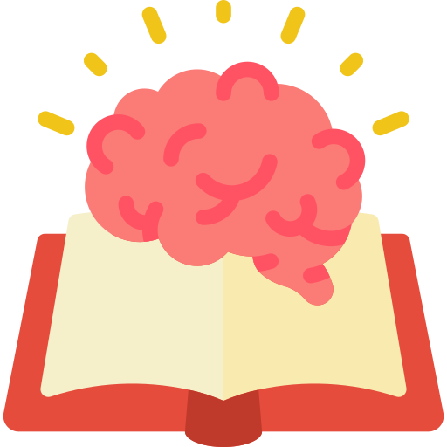
Learning Objectives
Learn to write Python code using the correct syntax, including how to define variables, and work with data types, decision statements, and control structures.
Understand how to use if, else, elif statements for decision-making and for and while loops for repetition in Python programs.
Learn to define and use functions to break down tasks into reusable blocks of code.
Understand essential data structures in Python, such as lists, dictionaries, and tuples, and how to manipulate them.
Learn how to read from and write to files using Python, enabling data storage and retrieval from external sources.
Understand OOP concepts like classes, objects, inheritance, and encapsulation.
Notes:
In this slide, Trainer would be making understand the students – What are the benefits of the topics, What will be objective. How the topic will be benefitted in order to develop the skill.
---------------------------------------------------
These are the expected knowledge, skills, and abilities that learners should acquire after completing a learning experience, such as a course, training program, workshop, or educational module.

Slide 6
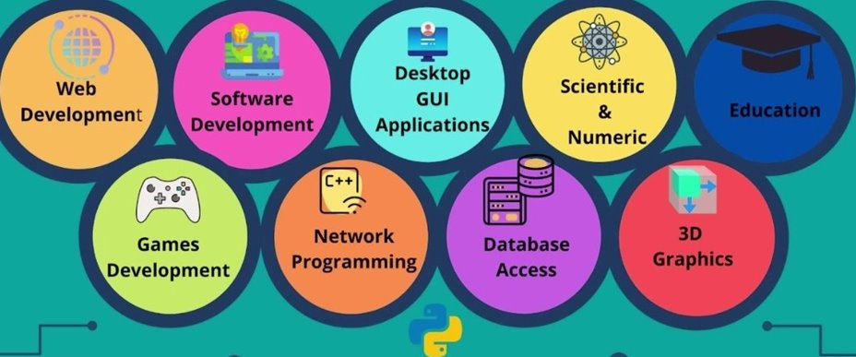
Python Use Cases
Click here
Reference link
Notes:
In this slide-Trainer will explain the use case of python .It will be exciting and beneficial for the students to know the different use cases of python.
-------------------------------------------
Python, a high-level and adaptable programming language, is a great option for backend development and integration with web apps and APIs.
Web Development is a very vast field, but in general, it means developing applications that can be accessed via the internet on a web browser. A web application has two components, frontend, and backend.
Frontend
The frontend is the part of a web application that deals with what users can see and interact with and how those interactions should appear.
Backend
Backend development with Python excels at serving server-side aspects of web apps. The backend manages storing, retrieving, and formatting data in a format agreed upon by other applications;
Desktop GUI Applications
So far, we've been talking about Python mainly as the backend but we can develop rich frontend applications using
Python. Tkinter library in Python can be used for designing user interfaces. Python toolkits like PyQT, Kivy PyGUI
etc. helps in designing Ul applications across platforms.
Example: Dropbox, a popular cloud storage service, was built using Python. The desktop application is built using
wxPython, which allows for seamless file synchronization and sharing

Slide 7

Introduction
Python is a high-level, interpreted programming language known for its simplicity, readability, and versatility. Python is a great choice for back-end development and integration due to its simplicity, extensive libraries, and frameworks. It offers various tools and frameworks that make it easy to build scalable, robust, and efficient back-end systems for web applications and APIs.
Notes:
Trainer would be briefing the students about the python language.
---------------------------------------------------
We're going to explore the world of programming today via the lens of Python, one of the most well-liked and useful programming languages available.Python is a tool that enables developers to build anything from straightforward scripts to intricate applications. Let's dive in and discover what makes Python unique and why it's a great place for both beginning and advanced programmers to start.

Slide 8

Introduction to Python
Characteristics of Python
Simple Syntax
GUI Programming.
Scalable
Free and Open Source
Variety of Usage and Application.
Interpreted and Interactive
Object Oriented
Notes:
Trainer would be briefing the students about the characteristics of python along with it trainer will ask to students to get there opinions
---------------------------------------------------
Simple Syntax
It is Closer to English language; Easy to Learn and more emphasis on the solution to the problem rather than the syntax
GUI Programming
Python supports GUI applications that can be created and ported to many system calls, libraries and windows systems, such as Windows MFC, Macintosh, and the
Window system of Unix.
Scalable
Python provides a better structure and support for large programs than shell scripting
Free and Open Source
It is Redistributable. Python is open-source and the community is always contributing to it to improve it. It is free and its source code is freely available to the public.
Variety of Usage and Application.
Interpreted and Interactive
Python is an interpreted language. It comes with the IDLE (Interactive Development Environment). This is an interpreter and follows the REPL structure (Read-Evaluate-Print-Loop). It executes and displays the output of one line at a time. So it displays errors while you’re running a line and displays the entire stack trace for the error.
Object Oriented
Python is object-oriented but supports both functional and object-oriented programming. Everything in Python is an object. It has the OOP (Object-oriented
programming) concepts like inheritance and polymorphism.

Slide 9
Introduction to Python
Advantages over other languages
Simple code
It is easy to understand
It is Free
It Needs Less Coding
All Kinds of Businesses Can Afford it
It is one of the most Trending languages.
Notes:
Trainer will be explaining to students about the advantages of python.
---------------------------------------------------
In the realm of programming languages, Python stands out for its remarkable advantages. Its simplicity and readability make it accessible to both newcomers and experienced developers, fostering collaboration and efficient maintenance. The extensive standard library empowers rapid development with a wealth of pre-built modules, saving time and effort. Python's cross-platform compatibility ensures seamless execution across various operating systems, while its vibrant community and third-party libraries offer versatile solutions to complex problems. Its adaptability, coupled with rapid development capabilities, solidifies Python as a dynamic language of choice across diverse domains

Slide 10
History
Python timeline/history and IEEE rankings
Python was conceptualized by Guido Van Rossum in the late 1980s.
Rossum Published the first version of Python code(0.9.0) in February 1991 at CWI(Centrum Wiskunde & Informatica) in Netherland, Amsterdam.
Python is Derived from ABC Programming Language developed at the CWI. Guido Van Rossum conceptualized Python Guido Van Rossum conceptualized Python
Notes:
In this slide - Trainer will briefing the students about the history of the language.
---------------------------------------------------
Python's origin story traces back to the late 1980s when Guido Van Rossum envisioned the language. In February 1991, he unveiled Python 0.9.0 at CWI in Amsterdam, influenced by the ABC programming language.

Slide 11
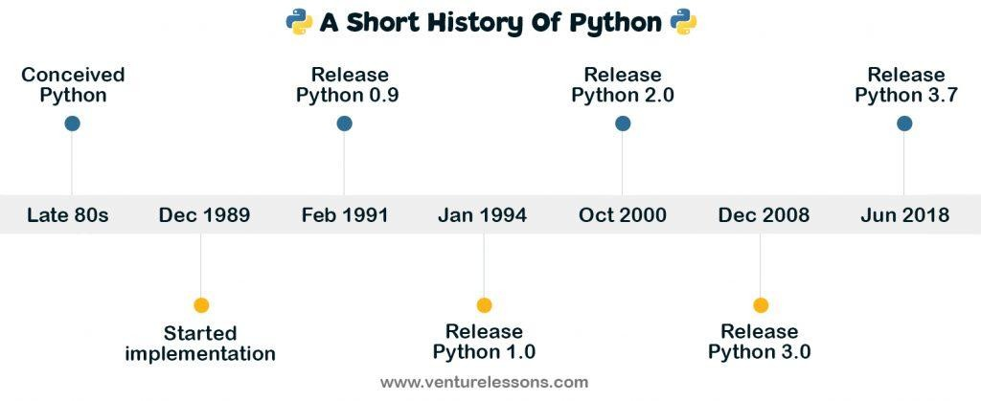
History
Python Timeline/History and IEEE rankings (Contd..)
Rossum choose the name “Python” since he was a big fan of Monty Python’s Flying Circus.
Python is now maintained by a core development team at the institute, although Rossum still holds a vital role in directing its progress.
Click here
Reference link
Notes:
In this slide - Trainer will briefing the students about the history and version of the language.
---------------------------------------------------
The whimsical name "Python" reflects Guido Van Rossum's admiration for Monty Python's Flying Circus. Presently, a dedicated core development team oversees Python's maintenance, with Rossum's ongoing guidance shaping its evolution.

Slide 12
Features
Easy to code and understand
Python has simpler syntax when compared to C, C++, Java, and other programming languages.
This enables any newbie to quickly pick up the basics of Python.
Also, despite being a high-level language, Python code looks very short much readable due to its English-like commands. In short,
It is a developer-friendly language.
Notes:
In this slide - Trainer will tell about the features of python to the students .
---------------------------------------------------
Python's ease of coding and comprehension makes it a user-friendly choice. Its developer-centric design enhances productivity and fosters a positive coding experience.

Slide 13
Features
Expressive Language
Python is very expressive when compared to other languages.
By expressive, we mean, in Python a single line of code performs a lot more than what multiple lines can perform in other languages.
In simple it means that fewer lines of code are required to write a program in Python.
Notes:
In this slide - Trainer would be briefing the students about features of python in detail
---------------------------------------------------
Python's expressiveness shines through its concise syntax and rich library support. This allows developers to achieve more with fewer lines of code, fostering efficient and elegant solutions.

Slide 14
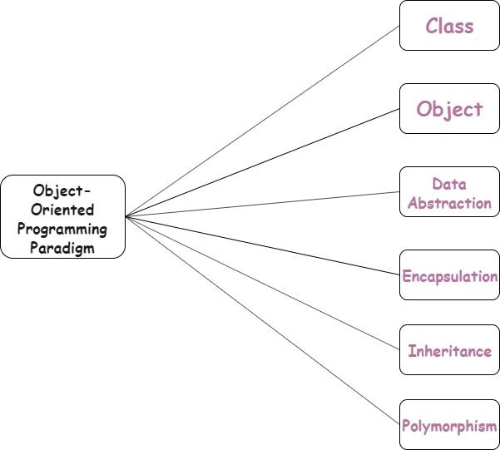
Features
Object Oriented
Python is a multi-paradigm programming language. Meaning, it supports different programming approach.
One of the popular approach to solve a programming problem is by creating objects.
This is known as Object-Oriented
Programming (OOP).
Python is an “object-oriented programming language.”
This means that almost all the code is implemented using a special construct called classes.
Click here
Reference link
Notes:
In this slide - Trainer would be briefing the students about features of python in detail
---------------------------------------------------
Python's robust support for Object-Oriented Programming (OOP) empowers developers to create modular, organized, and reusable code. Through classes and objects, Python facilitates encapsulation, inheritance, and polymorphism, enhancing code structure and maintainability. OOP principles enable the creation of complex systems with clear hierarchies and interactions, promoting efficient development and maintenance practices.

Slide 15
Features
Extensible Language
In case you want to write a part of your Python code in C++ or Java etc, then you can do it.
Since Python is an extensible language, it lets you do this with ease.
Notes:
In this slide - Trainer would be briefing the students about features of python in detail
---------------------------------------------------
Python's extensibility is a cornerstone of its strength. Through seamless integration with other languages like C and C++, developers can tap into existing libraries and leverage low-level optimizations. This ability to combine Python's simplicity with the power of other languages provides a flexible environment for solving diverse challenges, extending Python's capabilities to match specific needs.

Slide 16
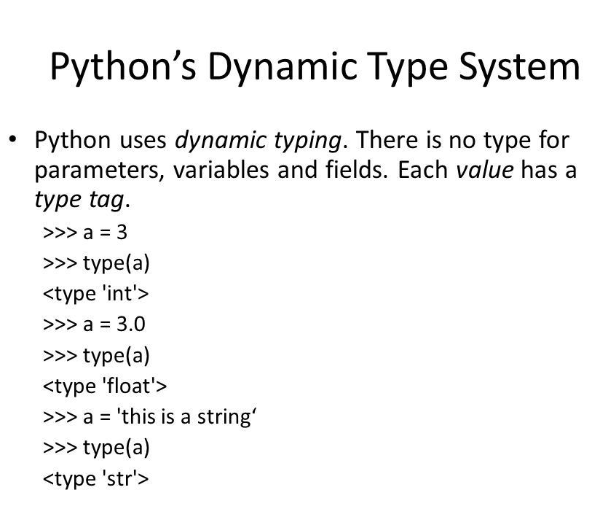
Features
Dynamically typed Programming Language
Python is a dynamically typed language.
This means, whenever a variable is declared, the programmer need not mention its data type.
Rather, the type of the variable is decided during run time.
Notes:
In this slide - Trainer would be briefing the students about features of python in detail
---------------------------------------------------
Python's dynamic typing sets it apart by allowing variables to change types on the fly. Unlike statically typed languages, Python doesn't require explicit type declarations, promoting quicker development. While this flexibility simplifies code writing, it's essential to maintain awareness of variable types during execution to avoid unexpected behaviors. This dynamic nature enhances agility and encourages adaptable coding practices.

Slide 17
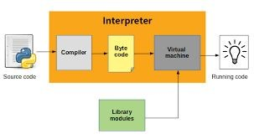
Features
Use of Interpreter
Python installation interprets and executes the code line by line at a time.
Python interpreter offers some pretty cool features:
Interactive editing
History substitution
Code completion on systems with support for readline
Click here
Reference link
Notes:
In this slide - Trainer would be briefing the students about features of python in detail
---------------------------------------------------
Python's use of an interpreter contributes to its agility and rapid development. Unlike compiled languages, Python's code is executed line by line, allowing for instant feedback during development. This interactive nature fosters quick experimentation, debugging, and iterative improvements, making it an ideal choice for prototyping and exploration. The interpreter facilitates a smooth and efficient coding process, reducing the need for time-consuming compilation steps.

Slide 18
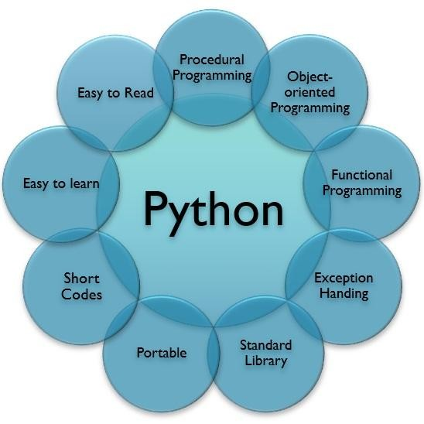
Features
Free & Open Source
Python language is freely available
i.e without any cost.
It is open and available to anyone.
Anyone can freely distribute it,read the source code and edit it.
Pythons license is administered by the Python Software Foundation.
Click here
Reference link
Notes:
In this slide - Trainer would be briefing the students about features of python in detail
---------------------------------------------------
Python's free and open-source nature democratizes programming access. Being open source means developers have access to its source code, fostering transparency, collaboration, and community-driven improvements. This empowers users to customize and contribute to the language's growth. Python's affordability and wide availability contribute to its popularity, making it accessible to learners, startups, and established organizations alike.

Slide 19
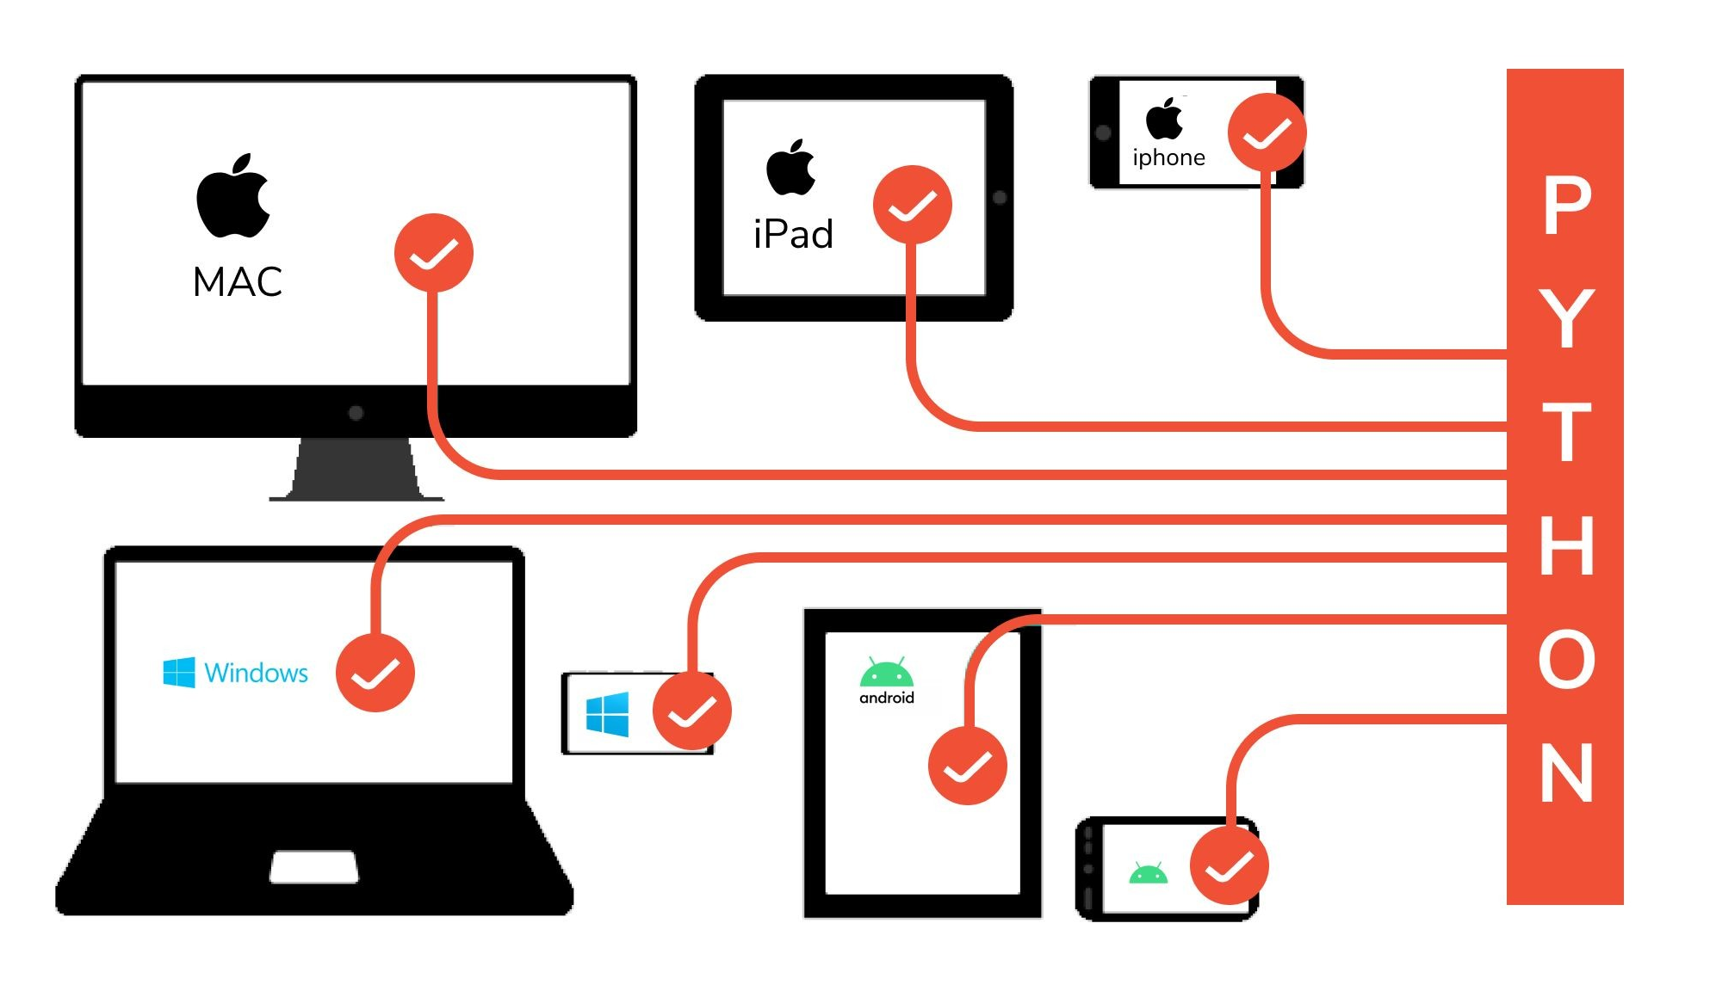
Features
Cross Platform Language
Python can run equally well on variety of platform :
Windows
Linux/Unix
Macintosh
Smart Phones etc
We can also say that Python is a portable language.
Click here
Reference link
Notes:
In this slide - Trainer would be briefing the students about features of python in detail
---------------------------------------------------
Python's cross-platform capabilities make it a versatile choice. Its code can run seamlessly on different operating systems without modification, reducing development efforts. This portability is achieved through Python's interpreter, which abstracts underlying system differences, ensuring consistency in behavior across platforms. This feature simplifies deployment and expands Python's reach to diverse environments.

Slide 20
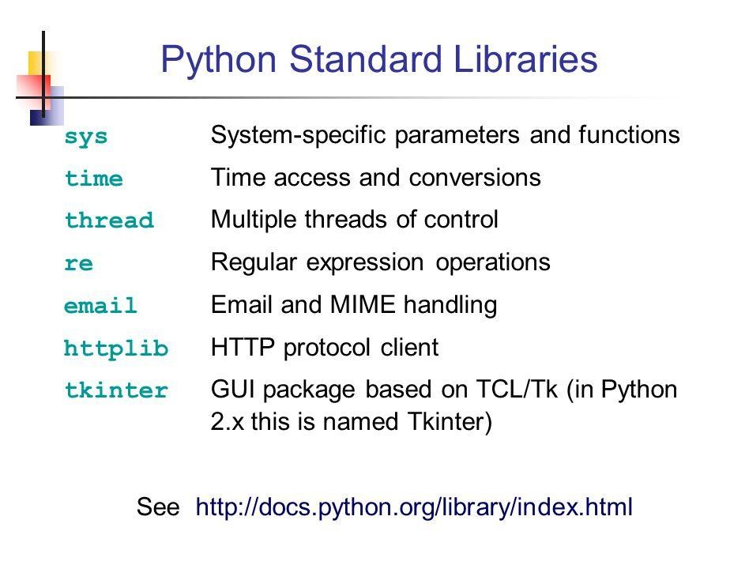
Features
Large Standard Library
Python has a large standard library and this helps save the programmers time as you don't have to write your own code for every single logic.
There are libraries for expressions, unit-testing, web browsers, databases, CGI, image manipulation etc.
Notes:
In this slide - Trainer would be briefing the students about features of python in detail
---------------------------------------------------
Python's extensive standard library is a treasure trove of pre-built modules and functions. This rich resource simplifies development by providing ready-made tools for various tasks, saving valuable time and effort. From data manipulation to networking and web development.

Slide 21
Features
Large Standard Library (Contd..)
Python provide rich set of module and functions for rapid application development
Python’s bulk of the library is very portable and cross-platform compatible on UNIX, Windows and Macintosh.
Notes:
In this slide - Trainer would be briefing the students about features of python in detail
---------------------------------------------------
Python's comprehensive library ecosystem empowers developers to achieve more with less code. This breadth of built-in functionality encourages efficient problem-solving and accelerates project completion.

Slide 22
Features
Elegant Syntax
Python Elegant Syntax means it is more capable of expressing the code’s purpose than many other languages.
Python can easily test even a small portion of code.
Python’s elegant syntax and dynamic typing, together with its interpreted nature, make it an ideal language for scripting and rapid application development in many areas on most
Notes:
In this slide - Trainer would be briefing the students about features of python in detail
---------------------------------------------------
Python's elegant syntax contributes to its aesthetic appeal and readability. With its clean and intuitive structure, developers can focus on the logic of their code rather than wrestling with complex syntax rules. This simplicity not only enhances collaboration but also reduces the chances of errors, leading to more efficient debugging and maintenance. Python's elegant design fosters a pleasant coding experience that encourages creative problem-solving.

Slide 23
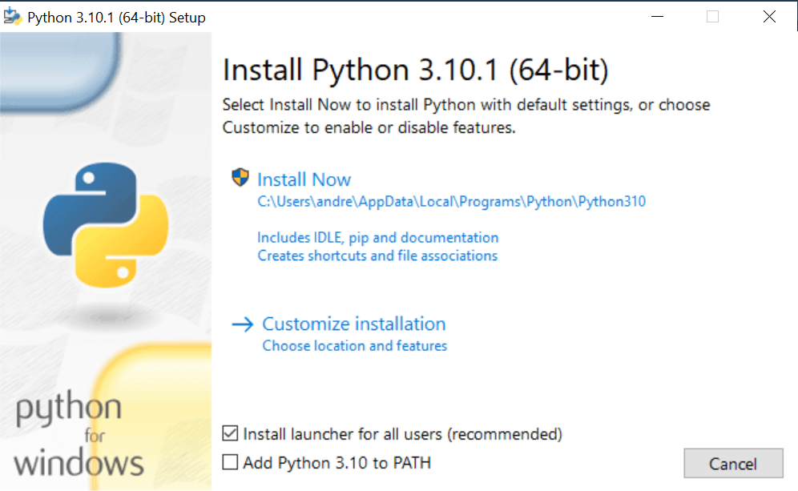
Setting Up Path
Installation of Python IDLE
List of Hardware/Software Requirements:
Laptop/Computer with Windows/Linux OS-Ubuntu 18.04LTS
Python Software
Installation Steps:
Install Python software in the system.
Open the browser and type the python.org/downloads.
Image source:
Notes:
In this slide - Trainer will briefing and showing the students how to install Python in there system
---------------------------------------------------
To set up the necessary environment for Python development, follow these steps. Ensure you have a Laptop/Computer with Windows or Linux OS, such as Ubuntu 18.04LTS. Install the Python software on your system by visiting python.org/downloads through your browser. This will provide you with the essential tools to start your Python programming journey.

Slide 24
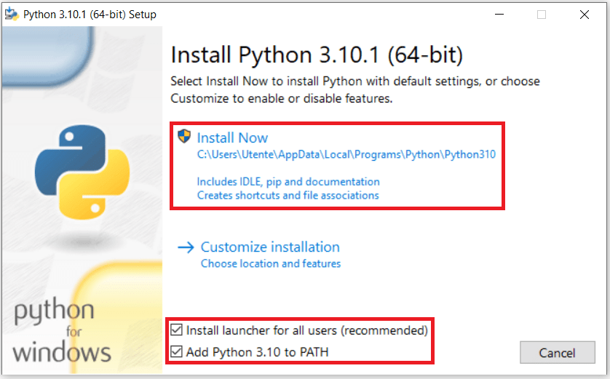
Setting Up Path
Installation of Python in Windows(Contd..)
Choice either Windows x86-64 executable installer for 64-bit or Windows x86 executable installer for 32-bit.
After downloading a file this page will appear.
Install the software
Select Add Python 3.10 to Path
Image source:
Notes:
In this slide - Trainer will showing the step by step process of installation to the students
---------------------------------------------------
For a smooth setup, choose the appropriate installer based on your system: Windows x86-64 executable installer for 64-bit or Windows x86 executable installer for 32-bit. Once the installer is downloaded, proceed to installation. The installation process will bring up the shown page. During installation, ensure to select the option "Add Python 3.10 to Path." This step ensures Python's accessibility from the command line, simplifying your development experience.

Slide 25
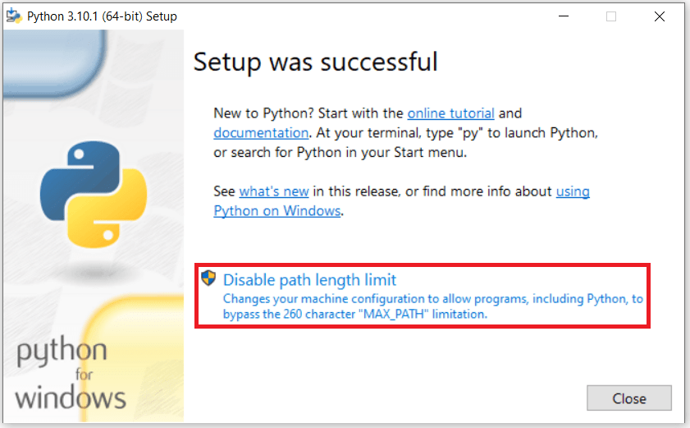
Setup Successful
Notes:
In this slide - Trainer will showing the setup successful to students
---------------------------------------------------
"Setup was Successful" message would be displayed on screen.

Slide 26
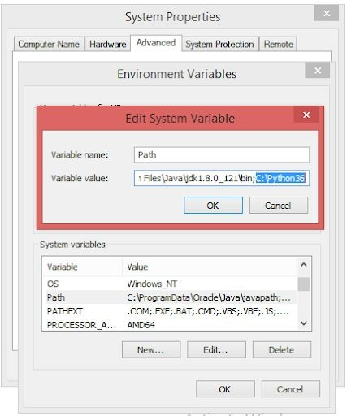
Setting Up Path
How to set python path in windows
To permanently modify the default
environment variables :
My Computer > Properties > Advanced System Settings > Environment Variables > Edit
Notes:
In this slide - Trainer will showing how to set the path because in some system we need to connect in the settings .
---------------------------------------------------
To establish a permanent Python path, follow these steps. First, navigate to "My Computer," then access "Properties." From there, go to "Advanced System Settings" and select "Environment Variables." Finally, within the "Edit" section, you can modify the default environment variables to ensure Python's path is set consistently for your system. This ensures Python's availability across various contexts.

Slide 27
Setting Up Path
How to set Python Path in Windows(Contd..)
Right-click 'My Computer'.
Select 'Properties' at the bottom of the Context Menu.
Select 'Advanced system settings'
Click 'Environment Variables...' in the Advanced Tab
Under 'System Variables': Click Edit
Add python path to the end of the list (the paths are separated by semicolons(;))
Notes:
In this slide - Trainer will showing how to set the path because in some system we need to connect in the settings .
---------------------------------------------------
Setting up the Python path is a crucial step in ensuring seamless access to the Python interpreter and its associated tools. To achieve this, begin by right-clicking on 'My Computer' and selecting 'Properties' from the ensuing Context Menu. This action leads you to the 'Advanced system settings' option, where you can click on 'Environment Variables...' within the Advanced Tab. Once there, under 'System Variables', locate and click on 'Edit'. To complete the process, add the Python path to the end of the list, with paths separated by semicolons(;). This adjustment guarantees that Python is readily available across various applications and contexts on your system.

Slide 28
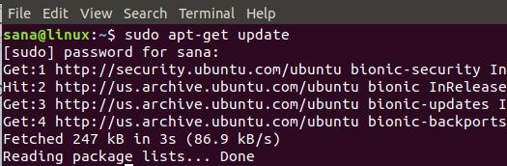
Setting Up Path
Installation of Python in Linux
Linux is an open source Operating System. There are many Linux based operating systems. Popular are Ubuntu, Fedora, Linux Mint, Debian.
Open the terminal or Command prompt from your linux based OS. Type the following commands.
If you are using Ubuntu 16.0 or newer version, then you can easily install Python 3.6 or Python 2.7 by typing the following commands
Notes:
In this slide - Trainer will showing how to set the path because in some system we need to connect in the settings .
---------------------------------------------------
When setting up Python on a Linux system, a series of steps ensures its proper installation and accessibility. Linux, known for its open-source nature, provides numerous operating system options like Ubuntu, Fedora, Linux Mint, and Debian. To begin the installation process, open the terminal or Command Prompt from your Linux-based OS. Depending on your Linux version, you can effortlessly install Python. For instance, if you're using Ubuntu 16.04 or a newer version, you can swiftly install Python 3.6 or Python 2.7 by entering the prescribed commands. This approach guarantees that Python becomes an integral part of your Linux environment, ready to be utilized for various programming tasks.

Slide 29
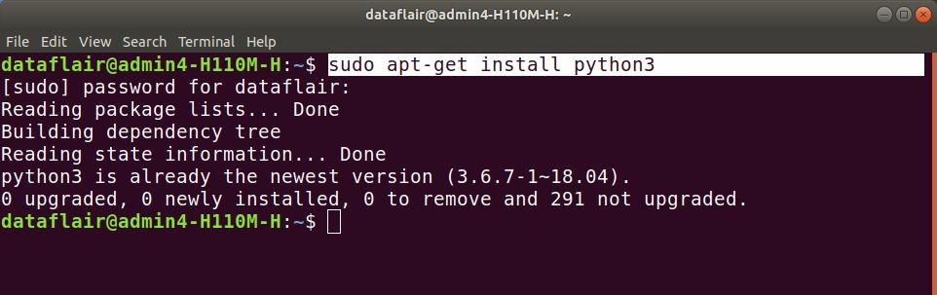
Setting Up Path
Installation of Python in Linux (Contd..)
$ sudo apt-get update
$ sudo apt-get install python3
or
$ sudo apt-get update
$ sudo apt-get install python2.7
Notes:
In this slide - Trainer will showing how to set the path because in some system we need to connect in the settings .
---------------------------------------------------
To establish the Python path within a Linux environment, a sequence of commands simplifies the process. Initiate by updating the package repository with the command `$ sudo apt-get update`. Following this, installing Python 3 is straightforward through the command `$ sudo apt-get install python3`. Alternatively, should you require Python 2.7, first update the package repository using `$ sudo apt-get update`, then proceed to install Python 2.7 with `$ sudo apt-get install python2.7`. These commands facilitate the integration of Python into your Linux system, enabling seamless access and utilization of the language's capabilities for your programming endeavors.

Slide 30
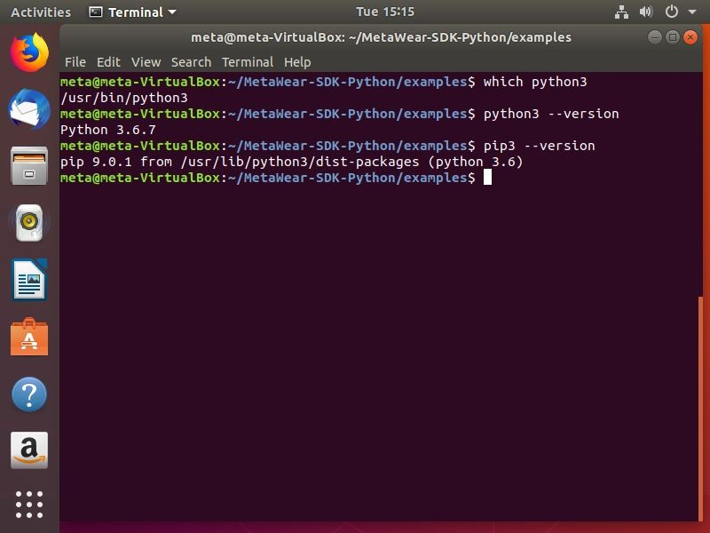
Setting Up Path
(Contd..)
Installation of Python in Linux
You can check it is installed or not by typing the following commands in terminal.
For Python3:-
$ python3 –version
For Python2:-
$ python2 --version
Notes:
In this slide - Trainer will showing how to set the path because in some system we need to connect in the settings .
---------------------------------------------------
To confirm the successful installation of Python, a straightforward verification process can be conducted through the terminal. By entering the command `$ python3 --version`, you can ascertain the installed version of Python 3. Similarly, for Python 2, using the command `$ python2 --version` will provide the corresponding version information. These quick checks offer immediate assurance that the installation has been executed correctly and that the Python interpreter is prepared for use in your programming endeavors.

Slide 31
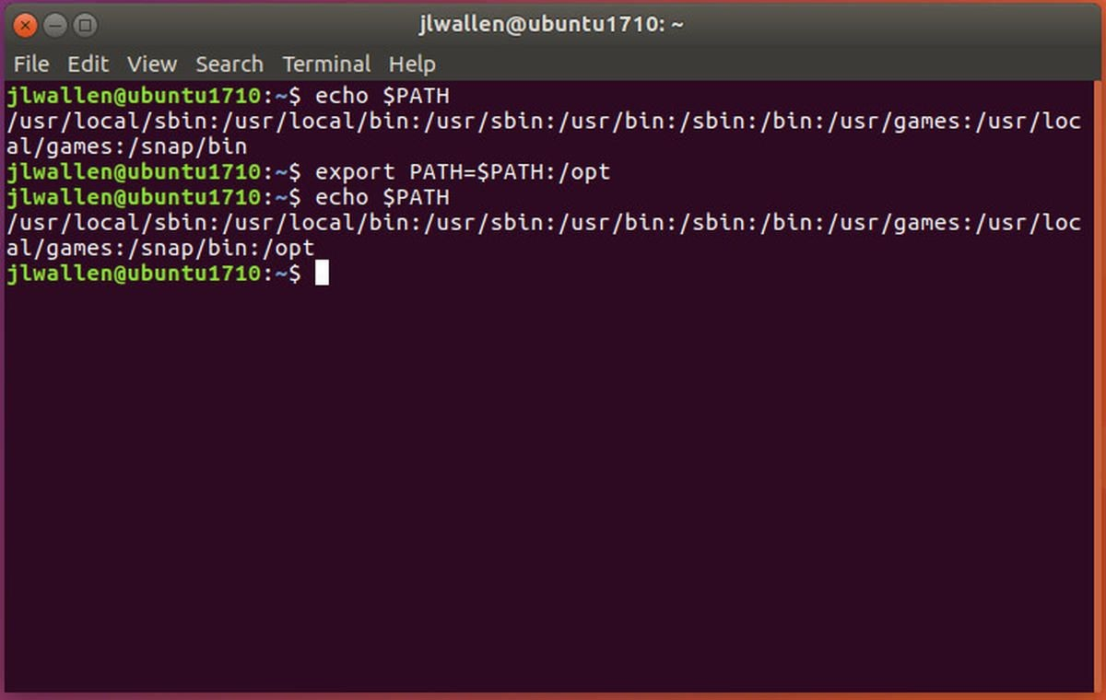
Setting Up Path
How to Set Python Path in Linux
The steps for adding Path in Linux are fairly straight forward, just follow the steps outlined below.
In the csh shell, type the following sentence:
PATH “$PATH:/usr/local/bin/python” and press Enter.
Notes:
In this slide - Trainer will showing how to Setti up the path in Linux involves straightforward steps. Follow the outlined process below:
---------------------------------------------------
1. While using the csh shell, input the command: `PATH "$PATH:/usr/local/bin/python"` and press Enter. This simple yet significant action adds the Python path to the existing environment path, ensuring seamless access to the Python interpreter and associated tools.

Slide 32
Setting Up Path
open up the bash shell and type the following phrase
Export
PATH=”$PATH:/usr/local/bin/python” and press Enter.
If you have access to either sh or ksh shell, then open up the terminal and type the following,
PATH=”$PATH:/usr/local/bin/python”and press Enter.
Notes:
In this slide - Trainer will showing how to Setti up the path in Linux involves straightforward steps. Follow the outlined process below:
---------------------------------------------------
To incorporate the Python path within various Linux shells, follow these steps:
1. In the bash shell, input the command: `export PATH="$PATH:/usr/local/bin/python"` and press Enter. This action ensures the Python path is seamlessly integrated.
2. For the sh or ksh shell, access the terminal and enter the following command: `PATH="$PATH:/usr/local/bin/python"` before pressing Enter. These steps, whether in csh, bash, sh, or ksh, guarantee Python's accessibility within the respective shell environments, streamlining your programming experience.

Slide 33
Setting Up Path
How to set python path in linux (contd..)
One of the most important things to note
when you are adding Path to Python in Unix or Linux is that, /usr/local/bin/python is the default path of the Python directory.
Notes:
In this slide - Trainer will showing how to Setti up the path in Linux involves straightforward steps. Follow the outlined process below:
---------------------------------------------------
An essential consideration when adding the Python path in Unix or Linux is the default directory, which is /usr/local/bin/python. This predefined location serves as the default path for the Python directory. Ensuring accuracy in specifying this default path is crucial as it establishes the foundation for a successful setup, enabling smooth accessibility to Python across Unix and Linux environments

Slide 34
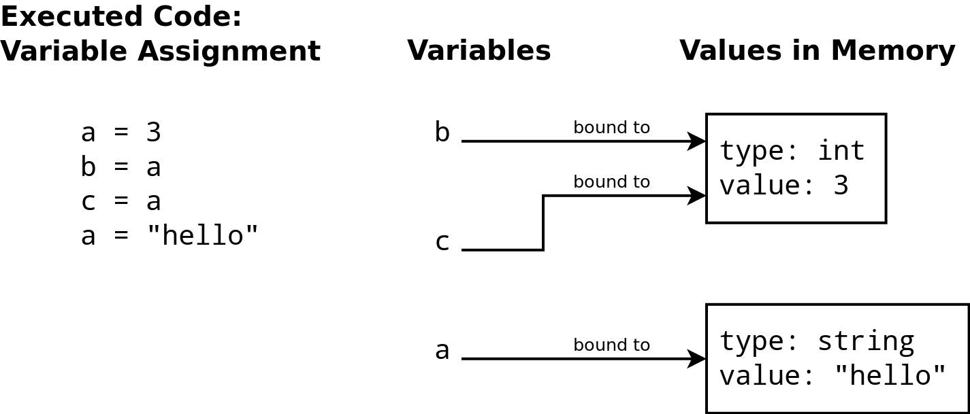
Basic Syntax Variable
Variables
A variable is a container for a value.
It can be assigned a name, you can use it to refer to it later in the program.
Based on the value assigned, the interpreter decides its data type.
Click here
Reference link
Notes:
In this slide - Trainer will briefing and showing the students about the basic syntax
---------------------------------------------------
Variables play a fundamental role in programming as they act as containers for values. By assigning a name to a variable, you can reference it throughout the program. The interpreter automatically determines the data type of the variable based on the assigned value. This dynamic nature of variables enables flexible and efficient data manipulation within your program.

Slide 35
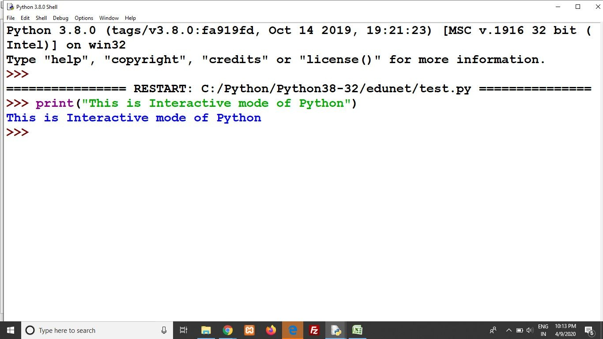
Basic Syntax Variable
Interactive Mode Programming
In Python, the code executes via the Python Shell, which comes with Python Installation.
To access the Python shell, open the terminal of your operating system and then type "python". Press the enter key and the Python shell will appear.
Notes:
In this slide - Trainer will briefing and showing the students about the basic syntax
---------------------------------------------------
Python offers an interactive mode of programming through the Python Shell, included with the installation. To access the Python shell, open your operating system's terminal and type "python," then press Enter. This action will launch the Python shell, enabling you to execute code interactively, making it a great environment for experimentation, quick tests, and learning.

Slide 36
Basic Syntax Variable
Interactive mode programming (contd..)
The indicates that the Python shell is ready to execute and send your commands to the Python interpreter.
The result is immediately displayed on the Python shell as soon as the Python interpreter interprets the command.
>>>
Notes:
In this slide - Trainer will briefing and showing the students about the basic syntax of variable
---------------------------------------------------
The Python shell's readiness for command execution is denoted by the ">>>" prompt, signaling your interaction with the Python interpreter. This prompt signifies that your input commands are being processed by the interpreter. As soon as the interpreter interprets a command, the resulting output is promptly displayed on the Python shell interface, facilitating real-time feedback and enhancing the interactive programming experience.

Slide 37
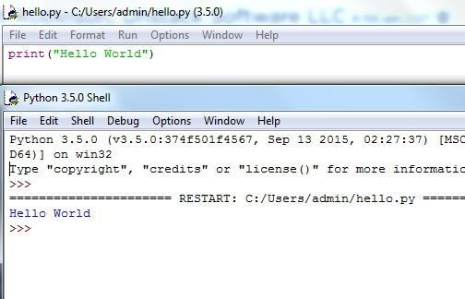
Basic Syntax Variable
Script Mode Programming
Script mode is used to work with lengthy codes.
In Script mode, You write your code in a text file then save it with a .py extension.
you can run your code by clicking”Run” then “Run module” or simply press F5.
You can use any text editor to wite the code like- Sublime, Atom, Notepad++, etc.
Notes:
In this slide - Trainer will briefing and showing the students about the basic syntax
---------------------------------------------------
Script mode in Python is ideal for managing lengthy codes efficiently. In this mode, you craft your code within a text file and save it with a .py extension. Running the code is achieved by clicking "Run," followed by "Run module," or simply pressing F5. Any text editor, such as Sublime, Atom, or Notepad++, suffices for writing your code, offering flexibility in choosing a preferred environment for code development and execution.

Slide 38
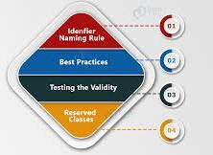
Basic Syntax Variable
Python Identifiers
A Python identifier is a name used to find a variable, function, class, module or other object.
An identifier begin with a letter A to Z or a to z or an underscore(_) followed by zero or more letters and digits (0 to 9).
Python doesn’t permit punctuation character such as @, $ and % within identifiers.
Python is a case sensitive Programming Language.
Click here
Reference link
Notes:
In this slide - Trainer will briefing and showing the students about the basic syntax
---------------------------------------------------
Python identifiers play a pivotal role in labeling variables, functions, classes, modules, and more. They commence with a letter (uppercase or lowercase) or an underscore, followed by letters and digits (0 to 9). However, punctuation characters like @, $, and % are not allowed in identifiers. It's essential to remember that Python is case-sensitive, distinguishing between lowercase and uppercase letters, influencing how identifiers are recognized and utilized in the code.

Slide 39
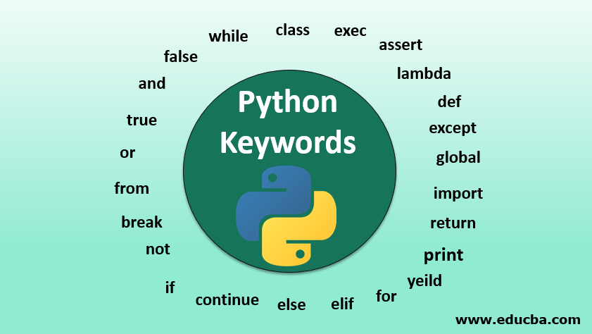
Basic Syntax Variable
Reserved Keywords
There are reserved words and cannot use them as constant or variable or any other identifier names.
All the Python keywords contain lowercase letters only.
Click here
Reference link
Notes:
In this slide - Trainer will briefing and showing the students about the keywords
---------------------------------------------------
Reserved keywords in Python hold specific meanings and cannot be employed as names for variables, constants, or any other identifiers. These words are reserved for specific programming tasks and should not be used for other purposes. Notably, all Python keywords are written in lowercase letters exclusively, making them easily distinguishable from user-defined identifiers. This distinction ensures clear communication with the Python interpreter and minimizes confusion in code interpretation.

Slide 40
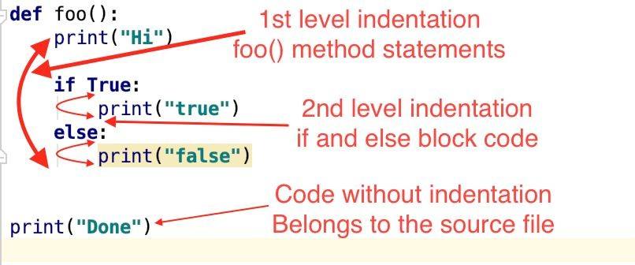
Basic Syntax Variable
Lines and Indentation
Python provides no braces to indicate blocks or code for class and function definitions or flow control.
Blocks of code are denoted by line indentation, which is rigidly enforced.
The number of spaces in the indentation is variable, but all statement within the block must be indented the same amount.
Click here
Reference link
Notes:
In this slide - Trainer will briefing and showing the students about the basic syntax of function
---------------------------------------------------
Python's approach to code blocks differs from languages that use braces. Here, indentation replaces braces to signify code blocks like class, function definitions, or control structures. This enforced indentation standard maintains code clarity. While the number of spaces for indentation varies, it's critical that all statements within a block share the same level of indentation, promoting a structured and organized codebase.

Slide 41
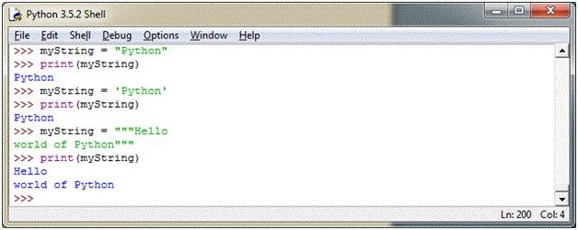
Basic Syntax Variable
Quotation in Python
Python accepts single (‘), double (“), and triple (''' or " "") quotes to denote string literals, as long as the same type of quote starts and ends the strings.
The triple quotes are used to span the string across multiple lines.
Notes:
In this slide - Trainer will briefing and showing the students about the basic of string
---------------------------------------------------
In Python, quoting strings offers versatility through single ('), double ("), and triple (''' or """) quotes. The crucial requirement is that the same type of quote initiates and concludes the string. Triple quotes excel in spanning strings across multiple lines, enhancing code readability. This feature grants programmers flexibility in handling string literals, making Python suitable for a wide array of applications.

Slide 42
Basic Syntax Variable
Quotation in Python (Contd..)
For example, all the followings are legal-
word = ’word’
sentence = “This is a sentence”
Paragraph = “””This is a paragraph. It is made up of multiple lines and sentences.”””
Notes:
In this slide - Trainer will briefing and showing the students about the basic of string for the (''"),(' ')
---------------------------------------------------
The variable "word" contains the string 'word' enclosed within single quotes. Similarly, the "sentence" variable holds the string "This is a sentence" enclosed in double quotes. Notably, the "Paragraph" variable employs triple quotes (''' or """) to encompass a multi-line string, effectively spanning multiple lines and sentences. These illustrative cases showcase Python's flexibility in accommodating different quoting styles, emphasizing its readability and adaptability for handling various text representations.

Slide 43
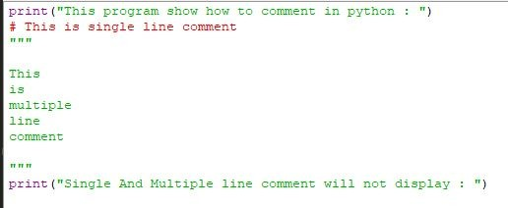
Basic Syntax Variable
Comments in Python
A hash sign (#) that is not inside a string literal begins a comment.
All characters after the # and up to the end of the physical line are part of the comment and the Python interpreter ignores them.
Notes:
In this slide - Trainer will briefing and showing the students about how to do commenting
---------------------------------------------------
In Python, comments are initiated by a hash sign (#) that isn't enclosed within a string literal. Any characters following the # until the end of the physical line constitute the comment. These commented portions are disregarded by the Python interpreter during execution. This commenting mechanism offers developers the ability to annotate their code for explanation, documentation, or temporarily disabling code segments, enhancing code readability and maintainability.

Slide 44
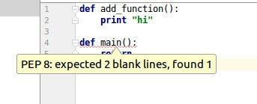
Basic Syntax Variable
Using Blank Lines
A line containing only whitespaces, possibly with a comment, is known as a blank line and Python totally ignores it.
In an interactive interpreter session, you must enter physical line to terminate a multiple statement.
Click here
Reference link
Notes:
In this slide - Trainer will briefing and showing the students about the main
---------------------------------------------------
Blank lines in Python, composed of whitespaces or comments, hold no significance and are completely ignored by the interpreter. They offer a means of visual separation for improved code readability and organization. In interactive sessions, a physical line is necessary to terminate multiple statements, ensuring accurate execution and coherent code structure. These practices collectively contribute to a more structured and understandable codebase.

Slide 45
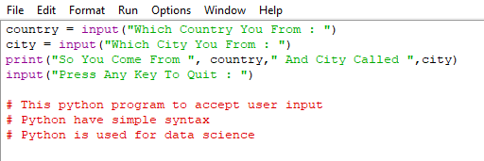
Basic Syntax Variable
Input from the User
Builtin function - input()
Image Source:
Notes:
In this slide - Trainer will briefing and showing the students about the input function
---------------------------------------------------
Python's interpreter offers a set of functions and types that are readily accessible. One of these is the built-in function `input()`. This function facilitates reading a line from a console or screen, often input through a keyboard, and subsequently converts it into a string. This process enables interactive user input, making it a valuable tool for creating dynamic and engaging programs.

Slide 46
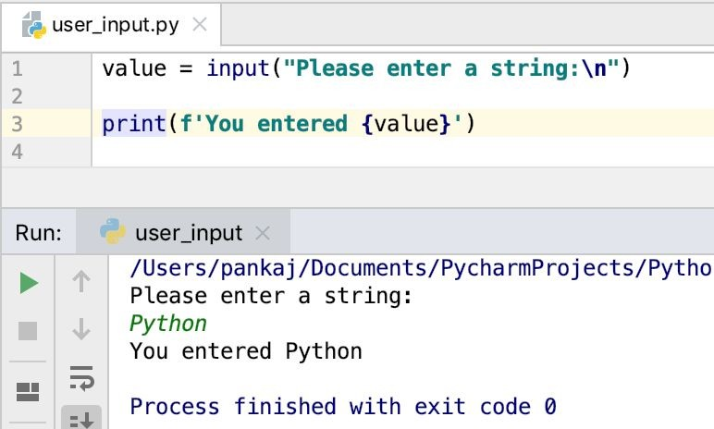
Basic Syntax Variable
Input from the User (Contd..)
even when the user inputs an integer value, it will still be considered as a string.
input()-
input() interprets and evaluates the input entered by the user, which means if the user enters an integer, an integer will be returned and if the user enters a string, a string will be returned.
Image Source:
Notes:
In this slide - Trainer will briefing and showing the students about the basic how input work
---------------------------------------------------
When users input an integer value using the `input()` function, it's important to note that the value will be treated as a string. Despite numerical input, it retains its string data type. The `input()` function interprets and assesses the input provided by the user. Consequently, if the user inputs an integer, the function returns an integer, and if a string is entered, the function returns a string. This behavior underscores the dynamic nature of user interactions in Python programming.

Slide 47
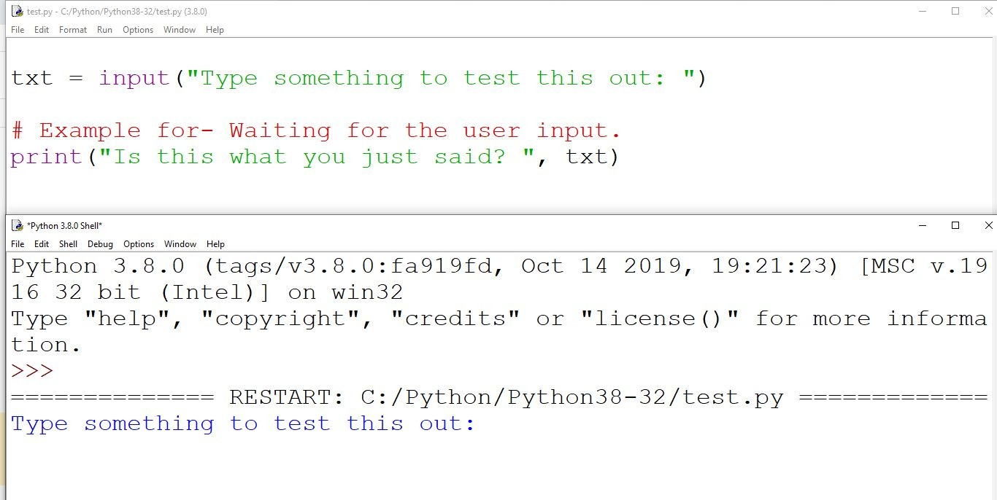
Basic Syntax Variable
Waiting for the User
The following line of the program displays the prompt, the statement saying “Press the Enter key to Exit”.
Wait for the user to take action-
raw_input(“/n/n Press the Enter key to Exit.”).
Here, /n/n is used to create two new lines before displaying the actual line.
Notes:
In this slide - Trainer will briefing and showing the students about the /n
---------------------------------------------------
To enhance user interaction, the program employs the line `raw_input("\n\n Press the Enter key to Exit.")`. This prompt halts program execution, waiting for user input. The `/n/n` in the statement introduces two new lines, creating spacing before the prompt. By adopting this approach, the program offers a pause for user engagement, enabling a clear and user-friendly interface.

Slide 48
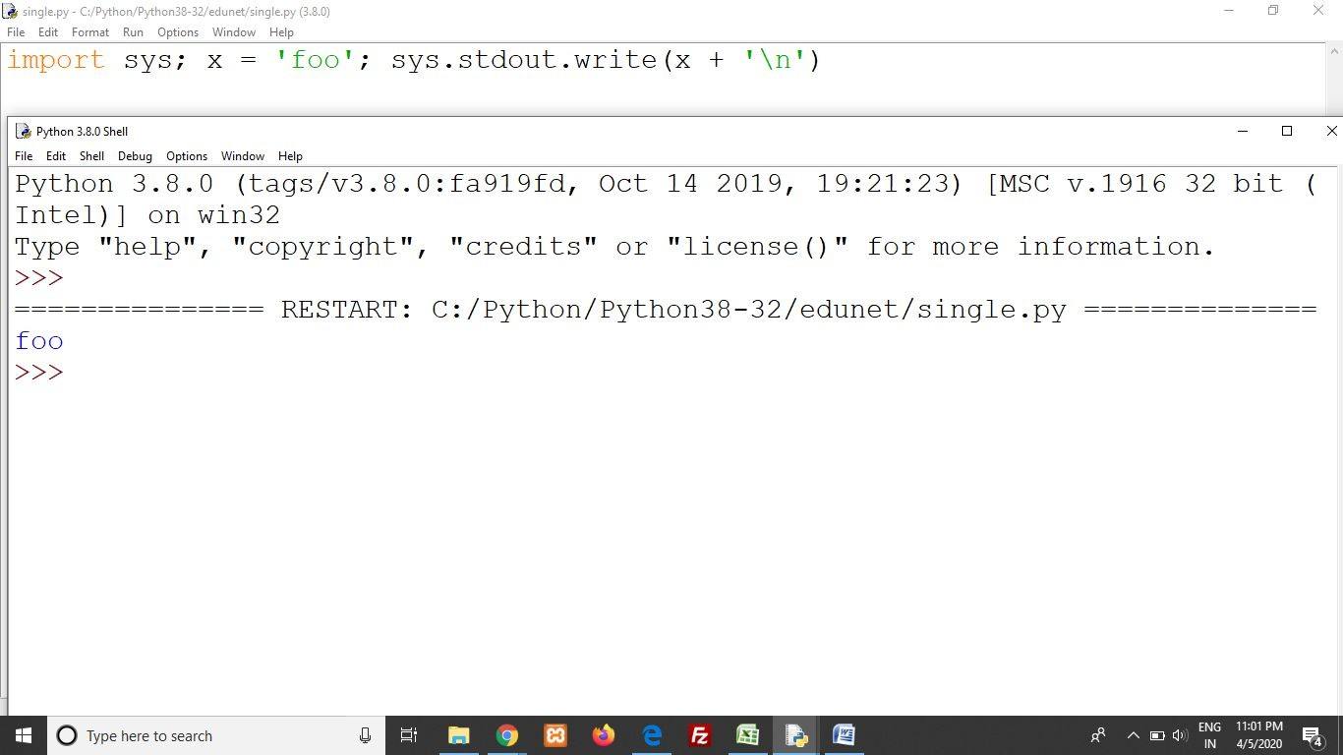
Basic Syntax Variable
Multiple statement on a single line
The Semicolon (;) allows multiple statements on the Single Line given that neither statement starts a new code block.
Here is a simple snip using the semicolon-
Import sys;x=”foo”sys.stdout.write(x+’\n’)
Notes:
In this slide - Trainer will briefing and showing the students about the multiple statement on a line
---------------------------------------------------
The semicolon (;) in Python permits combining multiple statements on a single line, as long as these statements do not initiate new code blocks. An example: `import sys; x = "foo"; sys.stdout.write(x + '\n')`. Here, the semicolon enables concise code by condensing multiple statements within a single line. This technique is useful for succinct code where each statement doesn't introduce a new code block, enhancing readability and efficiency.

Slide 49
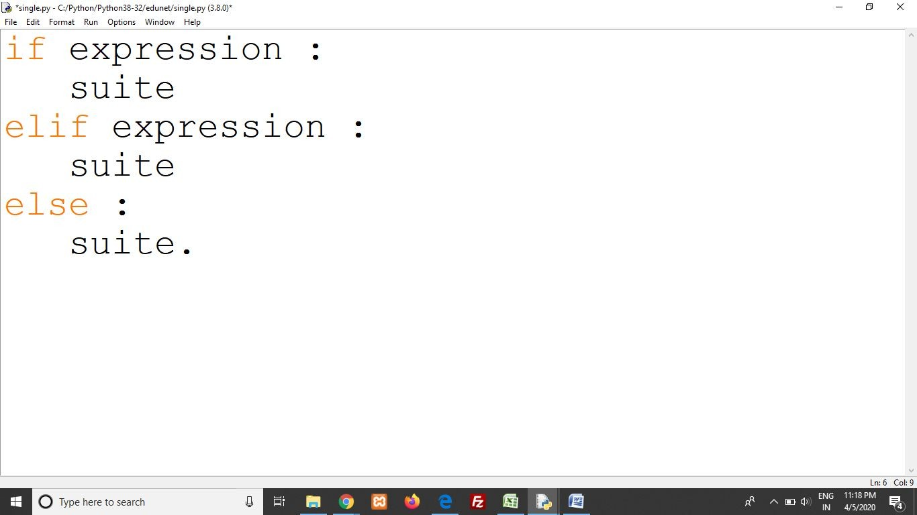
Basic Syntax Variable
Multiple Statement Groups as Suites
A group of individual statements, which make a single code block are called Suites in Python.
Compound or complex statements, such as if, while, def, and class require a header line and a suite.
Header lines begin the statement (with the keyword) and terminate with a colon ( : ) and are followed by one or more lines which make up the suite.
Notes:
In this slide - Trainer will briefing and showing the students about the importance of (:)
---------------------------------------------------
Using a semicolon (;) in Python facilitates placing multiple statements on a single line, provided none of these statements initiates a new code block. This technique condenses code for concise expression. For instance, consider `import sys; x = "foo"; sys.stdout.write(x + '\n')`, where the semicolon effectively separates three statements within a single line. This approach is suitable when consecutive statements don't introduce new code blocks, streamlining code without sacrificing clarity.

Slide 50
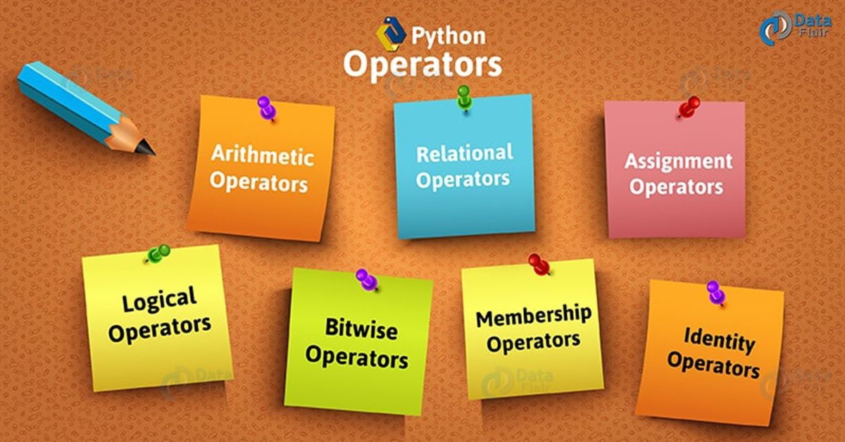
Data Types Operator
Click here
Reference link
Notes:
In this slide - Trainer will briefing and ask the students about the data type operatior
---------------------------------------------------
Let's discuss the python Data Types Operator.

Slide 51
Data Types Operator
Types of Operator
Python Arithmetic Operator
Python Comparison Operator
Python Assignment Operator
Python Bitwise Operator
Python Logical Operator
Python Membership Operator
Python Identity Operator
Python Operator Precedence
Click here
Reference link
Notes:
In this slide - Trainer will briefing and showing the students about the operation in python
---------------------------------------------------
Python encompasses various types of operators that facilitate different operations within programs. These include Python's arithmetic, comparison, assignment, bitwise, logical, membership, and identity operators. Each operator type serves a specific purpose, contributing to Python's versatility and effectiveness in performing diverse tasks. Understanding the array of operator types and their applications is fundamental to proficient Python programming.

Slide 52
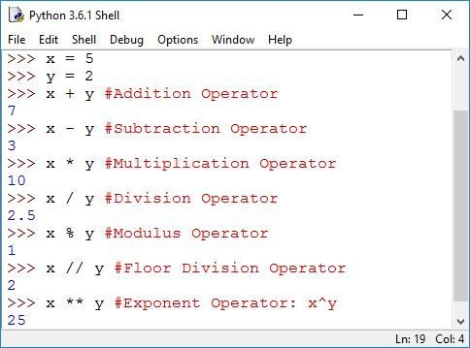
Data Types Operator
Python Arithmetic Operator
Arithmetic Operators are used to perform mathematical operations like addition, subtraction, multiplication etc.
Notes:
In this slide - Trainer will briefing and showing the students about the Arithmetic operation
---------------------------------------------------
Python's arithmetic operators are pivotal for conducting mathematical operations such as addition, subtraction, multiplication, and more. These operators enable developers to perform essential calculations within their programs. Recognizing and utilizing these arithmetic operators is essential for effective problem-solving and mathematical manipulation within Python programs.

Slide 53
Data Types Operator
Python Comparison Operator
Comparison Operators are used to compare values.
It either returns True or False according to the condition
Notes:
In this slide - Trainer will briefing and showing the students about the Comparison operation
---------------------------------------------------
Python's comparison operators play a crucial role in comparing values. These operators assess conditions and yield either True or False based on the comparison's outcome. By utilizing these operators, programmers can efficiently evaluate relationships between variables and make informed decisions in their code. Understanding and employing comparison operators is fundamental for logical branching and decision-making in Python programs.

Slide 54
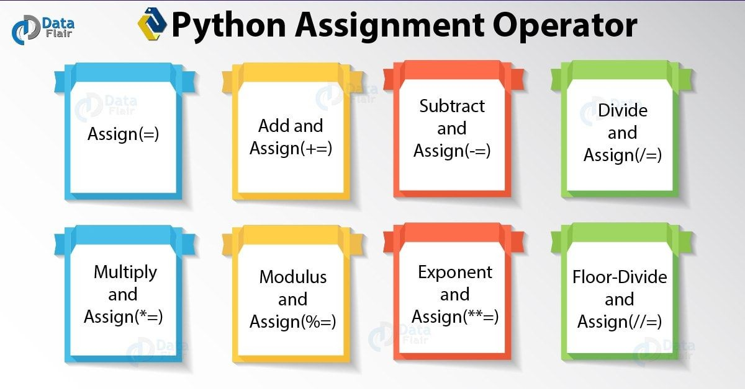
Data Types Operator
Python Assignment Operator
Assignment Operator are used to Python to assign values to variable.
Equals (=) operator is the most commonly used assignment operator in Python.
Click here
Reference link
Notes:
In this slide - Trainer will briefing and showing the students about the Assignment operation
---------------------------------------------------
Python's assignment operators facilitate the process of assigning values to variables. The equals (=) operator, the most frequently employed assignment operator, is used extensively in Python. This operator empowers programmers to associate values with variables, an essential practice in storing and manipulating data. Understanding assignment operators is pivotal for managing variable values and state changes within Python programs.

Slide 55
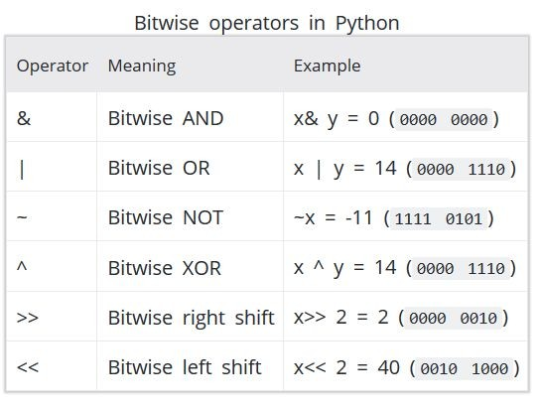
Data Types Operator
Python Bitwise Operator
Bitwise Operators act an Operand as if they were string of binary digits. It operates bit by bit hence, the name.
For eg- 2 is 10 in binary and 7 is 111.
Now In this table
Let x=10 (0000 1010 in binary) and y=4 (0000
0100 in binary)
Click here
Reference link
Notes:
In this slide - Trainer will briefing and showing the students about the Bitwise operation
---------------------------------------------------
Python's bitwise operators manipulate operands as if they were binary digit sequences. These operators perform operations at the bit level, giving them their name. For instance, the binary representation of 2 is 10, and 7 is 111. In the context of an example where x = 10 (0000 1010 in binary) and y = 4 (0000 0100 in binary), these operators provide a powerful means of manipulating individual bits, enabling sophisticated data manipulations within Python programs.

Slide 56
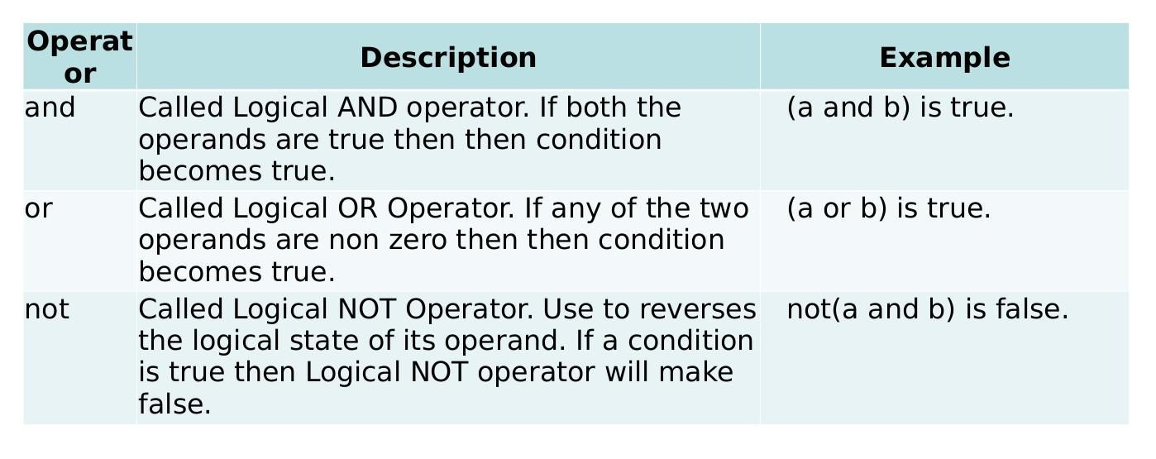
Data Types Operator
Python Logical Operator
There are three types of Python Logical Operator-
And Operator
Or Operator
Not Operator
Click here
Reference link
Notes:
In this slide - Trainer will briefing and showing the students about the Logical operation
---------------------------------------------------
Python's logical operators are essential for creating logical expressions and making decisions based on multiple conditions. Three primary logical operators in Python are:
1. And Operator
2. Or Operator
3. Not Operator
These operators allow developers to combine conditions, evaluate complex expressions, and control program flow based on logical outcomes. Mastery of these operators is crucial for building effective decision-making structures within Python programs.

Slide 57
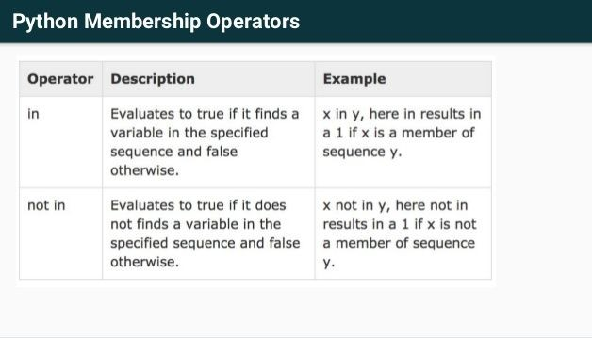
Data Types Operator
Python Membership Operator
in and not in are the membership operators in Python.
They are used to test whether a value or variable is found in a sequence (string, list, tuple, set and dictionary).
Click here
Reference link
Notes:
Python's membership operators, "in" and "not in," are essential for checking the presence of a value or variable within a sequence like a string, list, tuple, set, or dictionary. The "in" operator evaluates whether the item exists within the sequence, while the "not in" operator determines if the item is absent. These operators provide a means to efficiently ascertain the inclusion or exclusion of elements in various data structures, enhancing code functionality and decision-making.

Slide 58
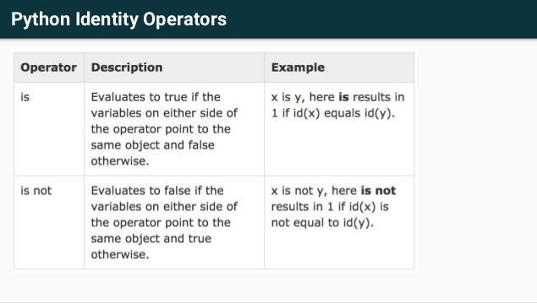
Data Types Operator
Python Identity Operator
is and is not are the identity operators in Python.
They are used to check if two values (or variables) are located on the same part of the memory.
Two variables that are equal does not imply that they are identical.
Click here
Reference link
Notes:
Python introduces identity operators - "is" and "is not" - that focus on memory locations. These operators help ascertain whether two values or variables share the same memory location. It's worth emphasizing that having equal values doesn't imply identical memory locations. Understanding these operators is vital for accurately evaluating object identity and enhancing precision in Python programming.

Slide 59
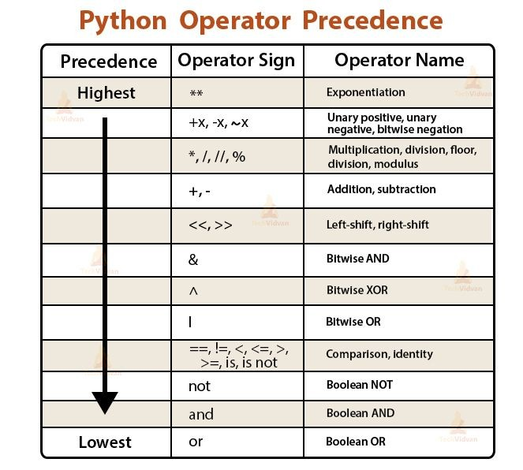
Data Types Operator
Python Operators Precedence
From the highest Precedence to the
lowest down the table.
Operators on the same row have the same Precedence.
Click here
Reference link
Notes:
In this slide - Trainer will briefing and showing the students about the operation
---------------------------------------------------
Python's operator precedence dictates the order in which operators are evaluated in an expression. Operators at the top of the precedence table hold higher precedence than those lower down. Operators on the same row possess equivalent precedence levels. Recognizing and adhering to operator precedence is crucial for accurate expression evaluation, ensuring that operations are performed in the intended sequence within Python programs.

Slide 60
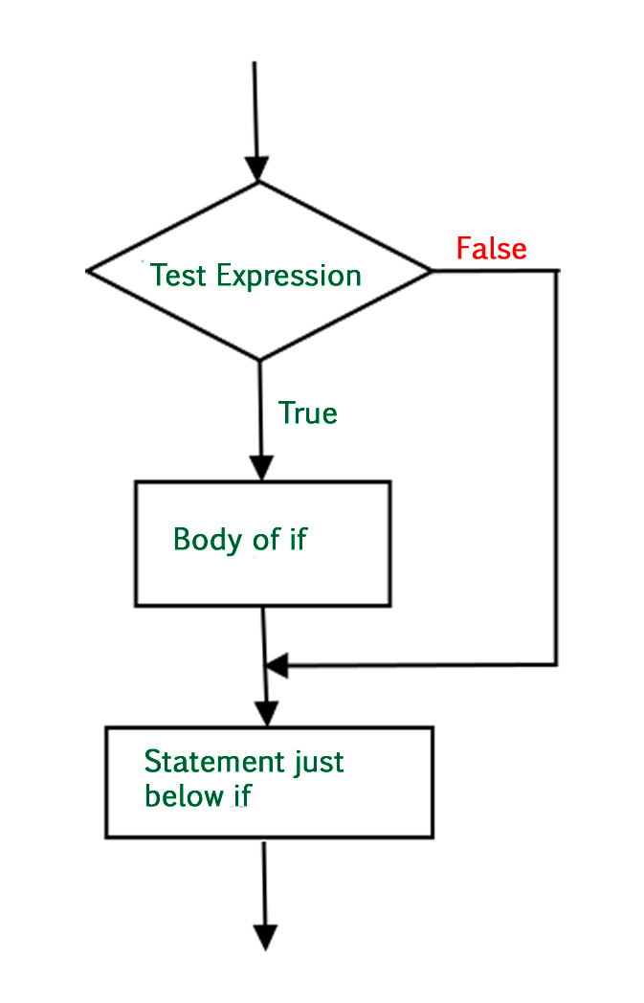
Conditional Statement
Statement And Description (Contd..)
The basic Decision statements in Computer is Selection Structure.
The Decision is described to computer as a conditional statement that can be answered True or False.
Python language provide the following conditional (Decision Making) statements.
If Statement
If...else Statement
If...elif...else Statement
Nested if...else Statement
Click here
Reference link
Notes:
Selection structures are fundamental decision-making constructs in computing. These structures allow computers to process conditions and make choices based on whether they are true or false. Python offers various conditional statements for decision-making:
1. If Statement
2. If...else Statement
3. If...elif...else Statement
4. Nested if...else Statement
These conditional statements empower developers to design robust decision pathways, enhancing the logic and control flow of Python programs.

Slide 61
Conditional Statement
Statement And Description (Contd..)
If statement-
The If statement is decision-making statement.
It is used to control the flow of the statement and also used to test logically whether the condition is true or false.
Syntax-
if test expression:
Click here
Reference link
Notes:
In this slide - Trainer will briefing the students about the Conditional statement
---------------------------------------------------
The "if" statement serves as a pivotal decision-making tool in programming. It directs the flow of statements by evaluating a specified condition for logical truth or falsehood. Depending on the result, the program follows different paths. By utilizing the "if" statement, programmers can effectively implement conditional logic, enabling the program to respond dynamically based on changing conditions.

Slide 62
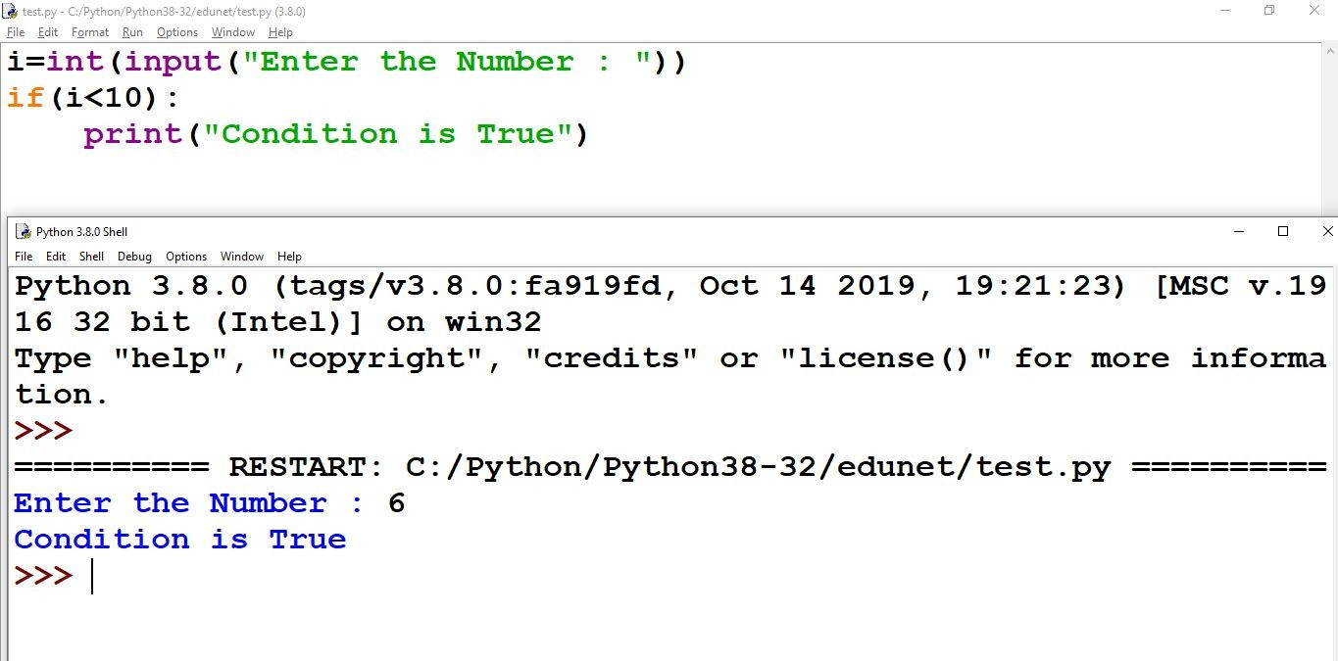
Conditional Statement
Statement And Description (Contd..)
Example Program:
i=int(input("Enter the Number : ")) if(i<10):
print("Condition is True")
Click here
Reference link
Notes:
In this slide - Trainer will briefing and showing the students about the if statement
---------------------------------------------------
The "if statement" is constructed using the keyword "if," forming a core element of conditional programming. In the presented instance, a user input variable "i" is subjected to the if statement's evaluation, checking if it's below 10. Upon user input, if the value of "i" meets this condition, the program displays "Condition is True." This illustrates how "if statements" enable dynamic response to varying conditions, enhancing program flexibility and interactivity.

Slide 63
Conditional Statement
Statement And Description (Contd..)
If..else statement-
The if..else statement is called alternative execution, in which there are two possibilities and the condition determines which one get executed.
Click here
Reference link
Notes:
In this slide - Trainer will briefing and showing the students about the if else statement
---------------------------------------------------
The if..else statement, referred to as alternative execution, offers two potential execution paths determined by a condition. If the condition is true, one block of code is executed; if false, an alternate block is executed. This construct is essential for handling binary decisions, effectively controlling the program's flow based on the evaluation of a condition. The if..else statement enhances program versatility, enabling tailored responses to different scenarios.

Slide 64
Conditional Statement
Statement And Description (Contd..)
Syntax-
If test expression:
Body of if
Else:
Body of else
Click here
Reference link
Notes:
In this slide - Trainer will briefing and showing the students about the if else statement
---------------------------------------------------
The "if..else" statement's syntax involves a test expression followed by a colon. Subsequently, the code block corresponding to the "if" branch is indented. The "else" keyword is then followed by a colon, and the corresponding code block for the "else" branch is indented as well. This syntax facilitates the creation of conditional structures where the program's flow branches based on the truth value of the initial test expression. Understanding and adhering to this syntax is crucial for accurate implementation of "if..else" statements in Python programs.

Slide 65
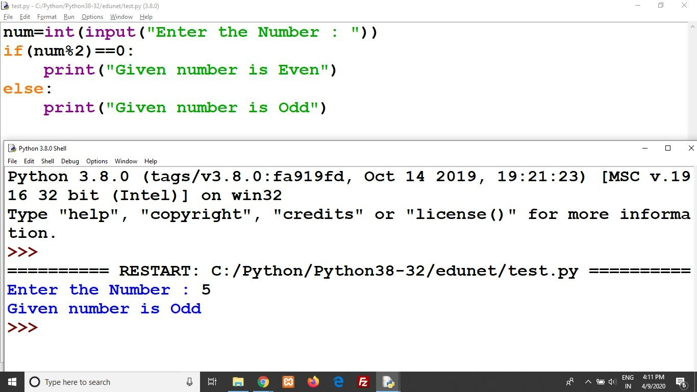
Conditional Statement
Statement And Description (Contd..)
num=int(input("Enter the Number : "))
if(num%2)==0:
print("Given number is Even") else:
print("Given number is Odd")
Notes:
In this slide - Trainer will briefing and showing the students about the if else statement
---------------------------------------------------
In this example, the "if..else" statement is utilized to determine if a user-entered number is even or odd. The test expression evaluates whether the number is divisible by 2. If the condition is true, the program displays "Even." If the condition is false, indicating an odd number, the program displays "Odd." This example underscores the dynamic decision-making capability of "if..else" statements, offering tailored responses based on the nature of the input.

Slide 66
Conditional Statement
Statement And Description (Contd..)
Elif Statement-
Elif is a keyword used in python in replacement of else if to place another condition in the program.
This is called chained conditional.
Chained conditions allows than two possibilities and need more than two branches.
Click here
Reference link
Notes:
In this slide - Trainer will briefing and showing the students about the elif statement
---------------------------------------------------
The "elif" statement is employed in Python as an alternative to "else if," offering the capability to introduce additional conditions in a program. This construct, known as a chained conditional, accommodates scenarios requiring more than two possible outcomes. By utilizing "elif," developers can craft branching structures that address multiple conditions, enhancing program adaptability and decision-making. This construct is pivotal for scenarios where code execution hinges on intricate conditions beyond simple "if..else" pairs.

Slide 67
Conditional Statement
Statement And Description (Contd..)
Elif Statement-
Elif is a keyword used in python in replacement of else if to place another condition in the program.
This is called chained conditional.
Chained conditions allows than two possibilities and need more than two branches.
Click here
Reference link
Notes:
In this slide - Trainer will briefing and showing the students about the elif statement
---------------------------------------------------
The syntax for using the "elif" statement involves an initial "if" expression followed by its corresponding code block. Subsequently, the "elif" keyword is used, along with a new expression, and the corresponding code block for the "elif" branch. Finally, the "else" keyword is used, and its corresponding code block is included. This syntax enables the creation of chained conditional structures, allowing the program to navigate multiple branching paths based on the truth values of different expressions. Understanding and following this syntax is crucial for correctly implementing "elif" statements in Python programs.

Slide 68
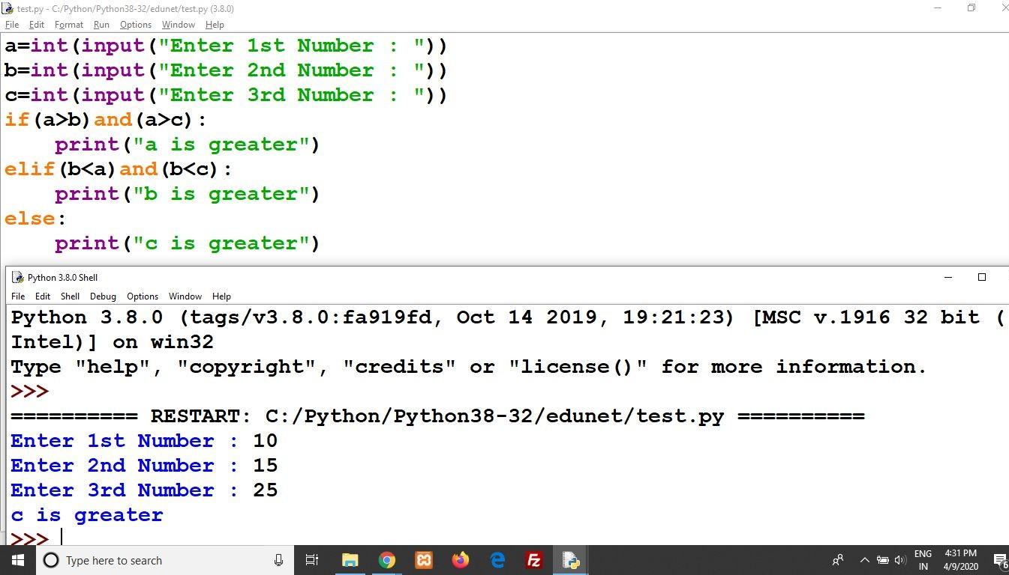
Conditional Statement
Notes:
In this slide - Trainer will briefing and showing the students about the conditional statement example
---------------------------------------------------
For example to check which entered number is greater amongst the three.

Slide 69
Conditional Statement
Statement And Description (Contd..)
elif(b<a)and(b<c):
print("b is greater") else:
print("c is greater")
Notes:
In this slide - Trainer will briefing and showing the students about the elif statement with an example
---------------------------------------------------
This chaining of conditions showcases the power of "elif" statements in creating multi-tiered decision pathways that address various possibilities. This example underscores how "elif" enhances the program's ability to handle complex branching scenarios effectively.

Slide 70
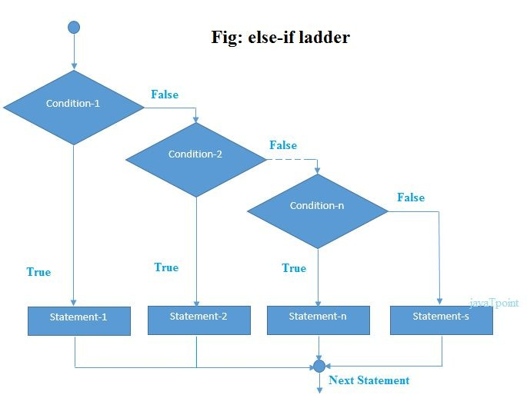
Conditional Statement
Statement And Description (Contd..)
Nested if...else statement-
We can write an entire if..else statement in another if..else statement called nesting, and the statement is called nested if.
In a nested if construct, you can have an if..elif..else construct inside an if..elif..Else construct.
Click here
Reference link
Notes:
In this slide - Trainer will briefing and showing the students about the Nested if else statement
---------------------------------------------------
The concept of nesting is a crucial aspect of programming, allowing us to embed an entire if..else statement within another if..else statement. This construct, known as a nested if, enables the creation of complex decision structures. Inside a nested if, one can have an if..elif..else construct, adding another layer of conditional logic. This technique is invaluable when addressing intricate scenarios that involve multiple conditions and outcomes. Understanding nested if..else constructs contributes to crafting more intricate and responsive Python programs.

Slide 71
Conditional Statement
Statement And Description (Contd..)
If expression1:
statement(s) If expression2:
statement(s) Elif expression3:
statement(s)
Else:
Click here
Reference link
Notes:
In this slide - Trainer will briefing and showing the students about the Nested if else statement
---------------------------------------------------
The syntax for a nested if..else statement involves multiple levels of conditional evaluation. The initial "if" expression1 is followed by its corresponding statement(s). Next, an "if" expression2 is presented, along with its associated statement(s). Within the same construct, an "elif" expression3 and its corresponding statement(s) are provided. Finally, the "else" statement concludes the construct with its corresponding statement. This syntax encapsulates a hierarchy of conditional logic, demonstrating how nested if..else statements offer advanced decision-making structures in Python programs.

Slide 72
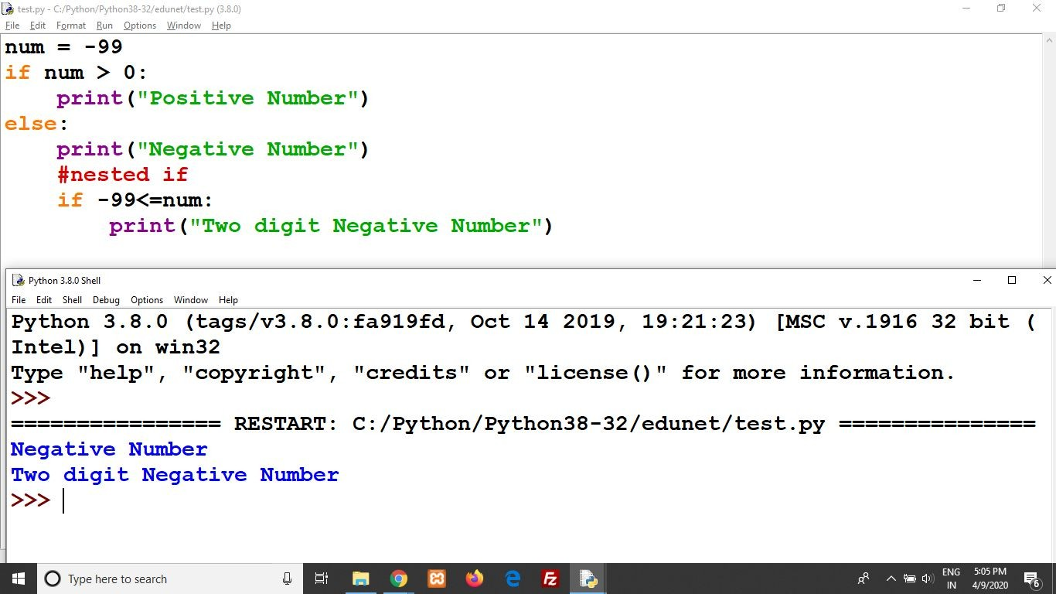
Conditional Statement
Statement And Description (Contd..)
Example Program-
num = -99 if num > 0:
print("Positive Number") else:
print("Negative Number")
Notes:
In this slide - Trainer will briefing and showing the students about the statement as example
---------------------------------------------------
For example to check whether entered number is positive or negative.
Display the image

Slide 73
Conditional Statement
Statement And Description (Contd..)
#nested if
if -99<=num
print("Two digit Negative Number")
Notes:
In this slide - Trainer will briefing and showing the students about the statement as example
---------------------------------------------------
Continued
Display the image

Slide 74
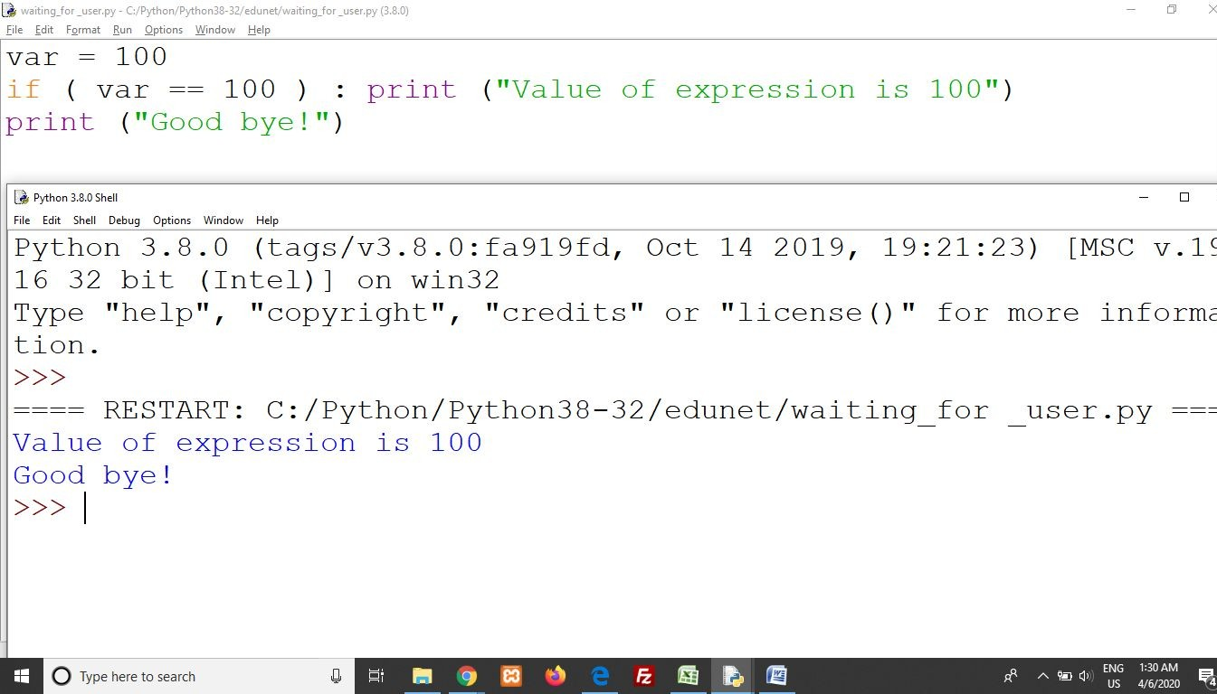
Conditional Statement
Single Statement Suites
If the suite of an if clause consists only of a single line, it may go on the same line as the header statement.
Here is an example of a one-line if clause −
Notes:
In this slide - Trainer will briefing and showing the students about the statement as example
---------------------------------------------------
When the suite of an if clause contains only a single line, Python allows it to be placed on the same line as the header statement. This approach, known as a one-line if clause, enhances code conciseness. An example demonstrates this technique, where the condition is assessed, and if true, the statement is executed in a single line. This technique is valuable for writing compact and straightforward code when the logic is simple and doesn't require extensive branching.

Slide 75
Conditional Statement - Lab 19
Click below
Conditional Statement
Notes:
In this slide, Trainer will ask the students to click on the link given in the slide – Conditional Statement – Which is a solved question based on a topic. Student may refer the questions, analyze the questions and after the concept is understood. Student may solve another question with the following link.
------------------------------------------------------------------------------------------------------------------------------
Practice Question -: https://github.com/edunetnextgen/Student-Development/blob/main/Full%20Stack%20Development%20with%20Cloud/Module%203/%20Lab%2019%20Ex.2%20Practice%20Question
Practice Question Solution -: https://github.com/edunetnextgen/Student-Development/blob/main/Full%20Stack%20Development%20with%20Cloud/Module%203/Lab%2019%20Ex.2%20Practice%20Question%20Solution

Slide 76
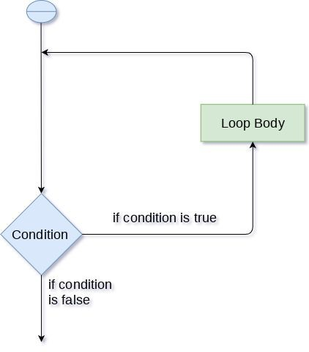
Looping
Loop Types and Description
The first statement in a function is executed first, followed by the second, and so on.
There may be a situation when you need to execute a block of code several number of times.
A loop statement allows us to execute a statement or group of statements multiple times.
The following diagram illustrates a loop statement −
Click here
Reference link
Notes:
In this slide - Trainer will briefing the students about the Looping
---------------------------------------------------
In programming, loops are essential for executing a block of code multiple times. The sequence of execution starts with the first statement in a function and proceeds sequentially. However, circumstances often arise where repeated execution is necessary. A loop statement provides the capability to achieve this, permitting the execution of a set of statements iteratively. This approach enhances efficiency and promotes code reusability. The diagram visually represents how a loop statement operates, showing the iterative nature of code execution.

Slide 77
Looping
Loop Structure
Program statement are executed sequentially one after another. In some situations, a block of code needs of times.
These are repetitive program codes, the computers have to perform to complete task,
Click here
Reference link
Notes:
In this slide - Trainer will briefing the students about the Looping
---------------------------------------------------
Loop structures are crucial for addressing scenarios where a specific block of code requires repetitive execution. Unlike sequential execution, these scenarios demand a set of statements to be repeated multiple times. These repetitive sections of code represent tasks that computers perform iteratively to accomplish specific objectives. Loops are instrumental in optimizing code and automating tasks that involve repetitive operations, contributing to efficient and effective programming.

Slide 78
Looping
Loop Structure (Contd..)
The following are the loop structures available in Python.
While Statement
For loop Statement
Nested Loop Statement
Click here
Reference link
Notes:
In this slide - Trainer will briefing the students about the Looping
---------------------------------------------------
Python offers several loop structures to cater to different types of repetitive tasks:
1. While Statement: This loop continues executing a block of code as long as the given condition remains true.
2. For loop Statement: The "for" loop iterates over a sequence, such as a list, string, or range, and executes a block of code for each element.
3. Nested Loop Statement: This construct involves embedding one loop inside another, allowing for more complex repetitive patterns and operations.
These loop structures provide programmers with the tools to manage various repetitive scenarios effectively, enhancing code efficiency and functionality.

Slide 79
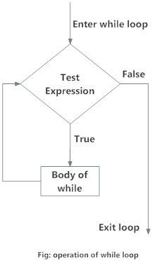
Looping
While Loop
A while loop statement in Python programming language repeatedly executes a target statement as long as a given condition is true.
It test the condition before executing the loop body.
The syntax of a while loop in Python programming language is −
While expression:
Statements(s)
Click here
Reference link
Notes:
In this slide - Trainer will briefing the students about the While Looping
---------------------------------------------------
A "while" loop in Python is employed to iteratively execute a designated set of statements as long as a particular condition holds true. The loop's validity is determined by evaluating the condition before executing each iteration, allowing for dynamic control over code repetition. The "while" loop's syntax involves expressing the condition using the "expression" and defining the corresponding block of "statements" to be executed. Understanding and utilizing this construct is crucial for implementing efficient and responsive iterative processes within Python programs.

Slide 80
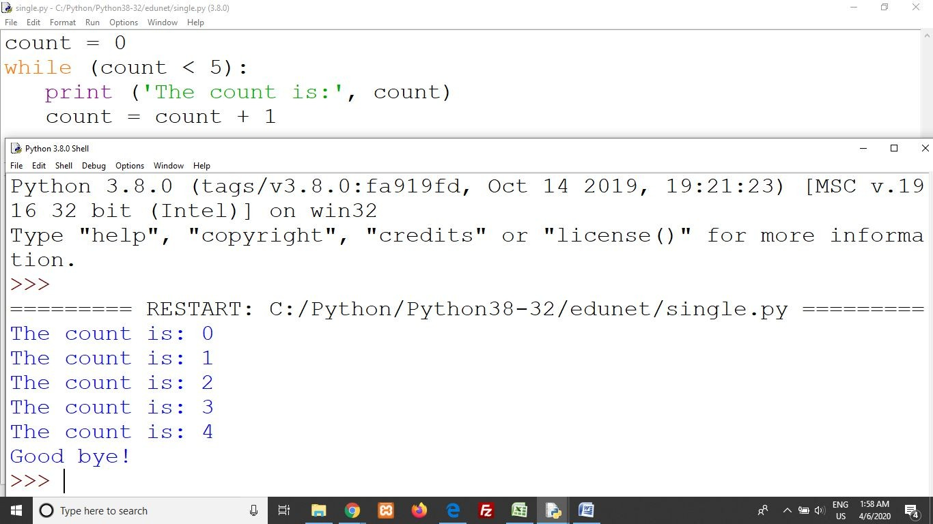
Looping
While Loop (Contd..)
Example Program-
count=0 while(count<5):
print(“The count is:”,count) count=count+1
Notes:
In this slide - Trainer will briefing and showing the students about the example of While Looping
---------------------------------------------------
For example to count the number using while loop
Display the image

Slide 81
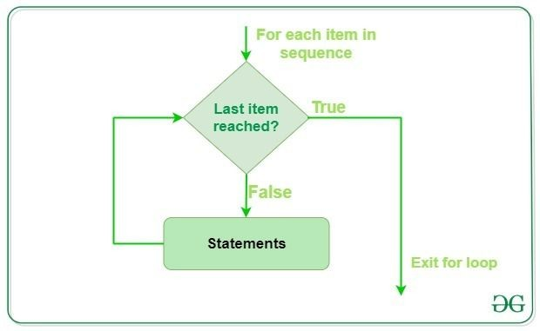
Looping
For Loop
Executes a sequence of statements multiple times and abbreviates the code that manages the loop variable.
The syntax of a for loop in Python programming language is −
for iterating_var in sequence: statements(s)
Click here
Reference link
Notes:
In this slide - Trainer will briefing and showing the students about the For Looping
---------------------------------------------------
The "for" loop in Python facilitates the execution of a sequence of statements multiple times, simplifying the management of the loop variable. This construct significantly condenses code when compared to traditional loop management approaches. The syntax of a "for" loop involves defining an "iterating_var" that traverses through a "sequence," and the corresponding block of "statements" to be executed for each element. Understanding and utilizing the "for" loop construct is pivotal for efficiently managing repetitive tasks in Python programs.

Slide 82

Looping
For Loop (Contd..)
Example Program-
fruits=[“apple”,”banana”,”cherry”] For x in fruits:
print(x)
OUTPUT-
Notes:
In this slide - Trainer will briefing and showing the students about the example of For Looping
---------------------------------------------------
Example to display the list of fruits using for loop
Display the image

Slide 83

Looping
Nested Loop
You can use one or more loop inside any another while, for or do..while loop.
A nested loop is a loop inside a loop.
The "inner loop" will be executed one time for each iteration of the "outer loop".
Click here
Reference link
Notes:
In this slide - Trainer will briefing the students about the Nested Looping
---------------------------------------------------
A nested loop involves embedding one or more loops inside another, whether they're "while," "for," or "do..while" loops. This construct is invaluable for addressing complex scenarios that require multiple levels of iteration. The inner loop executes once for every iteration of the outer loop, enabling intricate patterns of repetitive operations. Understanding and using nested loops effectively is crucial for managing intricate tasks that involve nested structures or multidimensional data.

Slide 84

Looping
Nested Loop (Contd..)
Example Program- adj=[“red”,”big”] fruits=[“apple”,”banana”] For x in adj:
For y in fruits:
print(x,y)
Notes:
In this slide - Trainer will briefing and showing the students about the example of Nested Looping
---------------------------------------------------
Example to display the use of nested for loop
Display the image

Slide 85
Control Statement
Loop Control Statements
Loop control statements change execution from its normal sequence.
When execution leaves a scope, all automatic objects that were created in that scope are destroyed
Python supports the following control statements.
Break Statement
Continue Statement
Pass Statement
Notes:
In this slide - Trainer will briefing and showing the students about the Looping control statement
---------------------------------------------------
Control statements in Python allow developers to modify the standard sequence of code execution. These statements play a crucial role in altering the flow of a program and managing scope-related elements. Python provides several loop control statements:
1. Break Statement: Used to terminate the loop prematurely, immediately exiting the loop's scope.
2. Continue Statement: Skips the current iteration and moves to the next iteration of the loop.
3. Pass Statement: Acts as a placeholder, allowing for syntactically valid code without any functional implementation.
These control statements are fundamental for effectively managing the behavior of loops and enhancing code control and flexibility.

Slide 86

Control Statement
Break Statement
Terminates the loop statement and transfers execution to the statement immediately following the loop.
If break statement inside a nested loop (loop inside another loop), break will terminate the innermost loop.
Click here
Reference link
Notes:
In this slide - Trainer will briefing the students about the Looping control Brake statement
---------------------------------------------------
The "break" statement in Python is used to abruptly end the current loop and direct program execution to the statement immediately following the loop. This enables swift termination of the loop's operation when a specific condition is met. In the case of nested loops, if a "break" statement is encountered, it only affects the innermost loop, halting its execution and allowing the outer loops to continue their iterations unaffected. Understanding the "break" statement is essential for precise control over loop execution and program flow.

Slide 87

Control Statement
Break Statement (Contd..)
Example Program-
For num in[11, 9, 88, 10, 90, 3, 19]:
print(num) if(num==88):
print(“The number 88 is found”) print(“Terminating the loop”) Break
Notes:
In this slide - Trainer will briefing and showing the students about the example of Looping control Break statement
---------------------------------------------------
Example to display the use of break statement
Display the image

Slide 88

Control Statement
Continue Statement
Causes the loop to skip the remainder of its body and immediately retest its condition prior to reiterating.
The continue statement can be used in both while and for loops.
Click here
Reference link
Notes:
In this slide - Trainer will briefing the students about the Looping control Continue statement
---------------------------------------------------
The "continue" statement in Python instructs the loop to skip the remaining portion of its body and immediately re-evaluate its condition for the next iteration. This enables the loop to restart its operation while bypassing the current iteration's code block. This statement is applicable to both "while" and "for" loops, allowing for controlled skipping of specific iterations. Understanding the "continue" statement contributes to crafting efficient loops that can effectively omit certain iterations based on specific conditions.

Slide 89

Control Statement
Continue Statement (Contd..)
Example Program-
For num in[20, 11, 9, 66, 4, 89, 44]:
If num%2==0: print(num)
Notes:
In this slide - Trainer will briefing and showing the students about the example of Looping control statement
---------------------------------------------------
Example to display the use of continue statement.
Display the image

Slide 90

Control Statement
Pass Statement
The pass statement in Python is used when a statement is required syntactically but you do not want any command or code to execute.
The interpreter does not ignore a pass statement, but nothing happens and the statement results into no operation.
Click here
Reference link
Notes:
In this slide - Trainer will briefing the students about the Looping Pass statement
---------------------------------------------------
The "pass" statement in Python is employed when a syntactically correct statement is necessary, but no actual command or code execution is desired. Unlike other control statements that alter program flow, the "pass" statement serves as a placeholder, indicating no action needs to be taken. Although the interpreter acknowledges the presence of a "pass" statement, it leads to no actual operations or changes in the program's behavior. Understanding and using the "pass" statement is valuable for creating structures with placeholders that can be later filled with actual code.

Slide 91

Control Statement
Pass Statement (Contd..)
Example Program-
For num in [20, 11, 9, 66, 89, 44]:
If num%2==0:
Pass
else:
print(num)
Notes:
In this slide - Trainer will briefing and showing the students about the example of Looping Pass statement
---------------------------------------------------
Example to show the use of pass statement
Display the image

Slide 92
Control Statement – Lab 20
Click below
Control Statement
Notes:
In this slide, Trainer will ask the students to click on the link given in the slide – Control Statement – Which is a solved question based on a topic. Student may refer the questions, analyze the questions and after the concept is understood. Student may solve another question with the following link.
Practice Question -: https://github.com/edunetnextgen/Student-Development/blob/main/Full%20Stack%20Development%20with%20Cloud/Module%203/Lab%2020%20Ex.2%20Practice%20Question
Practice Question Solution -: https://github.com/edunetnextgen/Student-Development/blob/main/Full%20Stack%20Development%20with%20Cloud/Module%203/Lab%2020%20Ex.2%20Practice%20Question%20Solution

Slide 93

String Manipulation
Notes:
In this slide - Trainer will briefing the students about the string Manipulation
---------------------------------------------------
String manipulation is a critical aspect of programming in Python, involving the manipulation and modification of strings to achieve various tasks. Python provides a wide range of string-related functions and methods to manipulate strings, including concatenation, slicing, formatting, replacing, and more. Effective string manipulation enhances data processing, text formatting, and output customization, making it an essential skill for programmers to efficiently work with textual data and create dynamic, user-friendly applications.

Slide 94
String Manipulation
Introduction
Python string is an ordered collection of characters which is used to represent and store the text-based information.
Strings are stored as individual characters in a contiguous memory location.
It can be accessed from both directions: forward and backward.
Characters are nothing but symbols.
Strings are immutable, which means that once a string is created, they cannot be changed.
Click here
Reference link
Notes:
In this slide - Trainer will briefing the students about the string Manipulation
---------------------------------------------------
String manipulation in Python involves working with sequences of characters, which are used to store and represent text-based information. Strings are composed of individual characters stored in a continuous memory location, facilitating bidirectional access. They are essentially collections of symbols, forming the textual content of data. It's crucial to note that strings are immutable, meaning their contents cannot be altered after creation. Understanding these characteristics of strings provides a foundation for effectively manipulating text data within Python programs.

Slide 95


String Manipulation
Create Strings
Strings can be created by enclosing characters inside a single quote or double-quotes.
Even triple quotes can be used in Python but generally used to represent multiline strings and docstrings.
Notes:
In this slide - Trainer will briefing the students about the string Manipulation how to create a string
---------------------------------------------------
Creating strings in Python is achieved by enclosing characters within single quotes (' '), double quotes (" "), or even triple quotes (''' ''' or """ """). Triple quotes are particularly useful for multiline strings and for creating docstrings, which serve as documentation for functions, classes, and modules. This flexibility in string creation enables developers to accommodate different types of text-based data efficiently. Understanding the various string representation methods allows for effective utilization of strings in Python programming, catering to different use cases and scenarios.

Slide 96


String Manipulation
Index and Slice - Indexing
Python allows to index from the 0th position in Strings. But it also supports negative indexes.
Index of ‘-1’ represents the last character of the String.
Similarly, using ‘-2’, we can access the penultimate element of the string and so on.
Click here
Reference link
Notes:
In this slide - Trainer will briefing the students about the string Manipulation Slice
---------------------------------------------------
In Python, string indexing begins from the 0th position, allowing direct access to individual characters within a string. However, Python also supports negative indexing, where an index of '-1' corresponds to the last character of the string. Utilizing '-2' grants access to the penultimate element, and this pattern continues for accessing characters in reverse order. This dual-indexing approach aids in flexible and intuitive manipulation of string content, enabling easy retrieval of specific characters for processing and analysis.

Slide 97

String Manipulation
Index and Slice - Slicing
To retrieve a range of characters in a String, we use ‘slicing operator,’ the colon ‘:’ sign.
With the slicing operator, we define the range as [a:b].
Let us print all the characters of the String starting from index ‘a’ up to char at index ‘b-1’. So the char at index ‘b’ is not a part of the output.
Click here
Reference link
Notes:
In this slide - Trainer will briefing the students about the string Manipulation slice slicing
---------------------------------------------------
Slicing is a powerful technique in Python to extract a specific range of characters from a string using the colon ':' operator. By defining the range as [a:b], the slicing operator retrieves characters starting from index 'a' up to, but not including, the character at index 'b'. This versatile method allows for precise control over extracting substrings, enabling efficient data processing and manipulation within strings. Understanding and applying slicing is essential for tasks that involve isolating and working with specific portions of text-based data.

Slide 98

String Manipulation
Modify/Delete Strings
Python Strings are by design immutable. It suggests that once a String binds to a variable, it can’t be modified.
If you want to update the String, then re-assign a new String value to the same variable.
We cannot delete or remove characters from a string. But deleting the string entirely is possible using the keyword del.
Notes:
In this slide - Trainer will briefing the students about the string Manipulation delete
---------------------------------------------------
Python strings are inherently immutable, meaning that once a string is assigned to a variable, its content cannot be directly modified. To update a string, a new value must be assigned to the same variable. Removing or deleting individual characters from a string is not possible; however, the entire string can be deleted using the 'del' keyword. This concept underscores the importance of careful string management and the need to employ appropriate methods for updating and manipulating string content in Python programs.

Slide 99

String Manipulation
String Operators
There are many operations that can be performed with string
Click here
Reference link
Notes:
In this slide - Trainer will briefing the students about the string Manipulation
---------------------------------------------------
String operators in Python offer a multitude of operations that can be executed on string objects. These operations include concatenation, repetition, membership testing, and various string manipulation functions. Understanding and utilizing these string operators enhance a programmer's ability to effectively work with textual data, process strings, and tailor them to specific requirements, thereby contributing to the development of versatile and dynamic applications.

Slide 100

String Manipulation
String Formatting Operators
An Escape sequence starts with a backslash (\), which signals the compiler to treat it differently.
Python subsystem automatically interprets an escape sequence irrespective of it is in a single-quoted or double-quoted Strings.
Click here
Reference link
Notes:
In this slide - Trainer will briefing the students about the string Manipulation
---------------------------------------------------
String formatting operators in Python include escape sequences, which are sequences of characters that begin with a backslash (\). These sequences signal the compiler to interpret them differently and perform specific actions, such as inserting special characters or formatting text. Importantly, Python's automatic interpretation of escape sequences applies whether they are used in single-quoted or double-quoted strings. This capability ensures consistent behavior across different string contexts and enhances the programmer's ability to manipulate and present text effectively within Python programs.

Slide 101


String Manipulation
String Formatting Operators
Python Format Characters
String ‘%’ operator issued for formatting Strings. We often use this operator with the print() function.
Click here
Reference link
Notes:
In this slide, the trainer would be briefing about the string manipulation operators which are represented with % sign.
----------------------------
Python's string formatting is facilitated using format characters, which are employed with the '%' operator. This operator is commonly used in conjunction with the print() function to format strings, enabling dynamic insertion of values and variables into predefined placeholders. Understanding the syntax and application of format characters enhances the readability and customization of output in Python programs, making them more informative and user-friendly.

Slide 102

String Manipulation
Unicode String support
Regular Strings stores as the 8-bit ASCII value, whereas Unicode String follows the 16-bit ASCII standard.
This extension allows the strings to include characters from the different languages of the world.
In Python, the letter ‘u’ works as a prefix to distinguish between Unicode and usual strings.
Notes:
The trainer in this slide, would be discussing about the unicode string support. The trainer may also ask the students about unicode terminology.
----------------------------------
Python supports Unicode string literals, which differ from regular strings by following the 16-bit ASCII standard instead of the 8-bit ASCII value. This extension enables Unicode strings to accommodate characters from various languages globally. To distinguish Unicode strings from regular ones, the letter 'u' is used as a prefix in Python, signifying the utilization of Unicode character encoding. This Unicode support contributes to Python's versatility and its ability to handle text data from diverse linguistic contexts.

Slide 103

String Manipulation
Regular Expressions
A RegEx, or Regular Expression, is a sequence of characters that forms a search pattern.
RegEx can be used to check if a string contains the specified search pattern.
Python has a built-in package called re, which can be used to work with Regular Expressions.
Notes:
Here, in this slide the trainer would be explaining to the students about the regular expression also known as regex, which help the developer to search a pattern.
------------------------------
Regular Expressions, commonly referred to as RegEx, are sequences of characters that define search patterns. These patterns can be employed to ascertain whether a string conforms to a specified search criteria. Python incorporates a built-in package called "re," specifically designed to work with regular expressions. Leveraging this package, programmers can effectively employ regular expressions to search for and manipulate strings according to complex and dynamic patterns, enhancing the text processing capabilities of Python programs.

Slide 104

List
Notes:
In this slide, the trainer would be explaining about the list, how to create a list, multiple ways of creating a list.
----------------------------
In Python, a list is a versatile and dynamic data structure used to store collections of items. Lists can contain elements of various data types and can be modified after creation. They are defined using square brackets and can be accessed using indexes. Lists facilitate the organization, manipulation, and iteration over items, making them fundamental components of Python programs for managing data and implementing a wide range of algorithms.

Slide 105
List
Python List & Create List
In Python programming, a list is created by placing all the items (elements) inside a square bracket [ ], separated by commas.
It can have any number of items and they may be of different types (integer, float, string etc.).
Notes:
Here, the students will be aware about the sequence data types known as list – Trainer may also ask the students about the word sequence which is used here in context of the datatype.
-----------------------------------
A Python list is formed by enclosing elements within square brackets [ ] and separating them with commas. Lists can encompass a variable number of items, and these items can belong to different data types, including integers, floats, and strings. The dynamic nature of lists and their ability to accommodate diverse data types makes them indispensable tools for managing collections of data in Python programs, enhancing flexibility and versatility in data handling tasks.

Slide 106

List
Creating Multi-dimensional Lists
A list can hold other lists as well which can result in multi-dimensional lists.
Notes:
In this the trainer would be explaining the students the concept of multi-dimensional lists.
----------------------
Python's list data structure is not limited to holding only basic data types; it can also contain other lists. This enables the creation of multi-dimensional lists, where each element within the main list can itself be a list. This capability allows for the representation of more complex data structures, such as matrices or tables, in a convenient and organized manner. Multi-dimensional lists enhance Python's ability to handle diverse types of data and facilitate the implementation of advanced algorithms and data structures.

Slide 107

List
Access elements from a list List indexing
Index operator : The simplest one is to use the index operator ([ ]) to access an element from the list. Since the list has zero as the first index, so a list of size ten will have indices from 0 to 9.
Any attempt to access an item beyond this range would result in an IndexError. The index is always an integer.
Using any other type of value will lead to TypeError.
Notes:
In this slide, the trainer would be explaining the students about the indexing in the list. What is the different between index and position.
-----------------------------------
Accessing elements from a list in Python is achieved using the index operator ([ ]). Lists are zero-indexed, meaning the first element corresponds to index 0, the second to index 1, and so on. Attempting to access an index beyond the list's size results in an IndexError. The index value must always be an integer; using any other data type will result in a TypeError. The index operator provides a straightforward and common method for retrieving specific elements from a list, aiding in efficient data manipulation and retrieval.

Slide 108

List
Access elements from a list
Reverse/Negative indexing
Reverse indexing : Python enables reverse (Negative) indexing for the sequence data type. So, for the Python list to index in the opposite order, you need to set the index using the minus (-) sign. Indexing the list with “-1” will return the last element of the list, -2 the second last and so on.
Notes:
In this slide, the trainer would brief the students about reversing of a list and different methods also.
----------------------------
Reverse or negative indexing in Python allows for accessing list elements in reverse order. By using negative indices, such as "-1" for the last element, "-2" for the second-to-last, and so on, you can access elements from the end of the list. Python's support for reverse indexing enhances the flexibility of data manipulation and retrieval, providing a convenient way to work with lists in both the forward and backward directions. This feature is particularly useful when you need to access items from the end of a list without needing to calculate the exact position.

Slide 109

List
List slicing
Python comes with a magical slice operator which returns the part of a sequence.
It operates on objects of different data types such as strings, tuples, and works the same on a Python list.
Notes:
In this slide, the trainer would brief the students about slicing of a list.
----------------------------
List slicing in Python is a powerful feature that allows you to extract a portion of a sequence, such as a list, string, or tuple. The slice operator provides a concise way to retrieve specific elements based on their indices. This operator works consistently across different data types, including strings, tuples, and lists. By specifying the start and end indices of the desired portion, you can easily create subsets of data, enabling more efficient data manipulation and analysis. List slicing is a valuable tool for working with sequences in Python and enhances code readability and efficiency.

Slide 110

List
Change or Add elements
List are mutable, meaning, their elements can be changed unlike string or tuple.
We can use assignment operator (=) to change an item or a range of items.
We can also use + operator to combine two lists. This is also called concatenation.
The * operator repeats a list for the given number of times.
Click here
Reference link
Notes:
In this the trainer would be completing the slicing part of the list and students may also answer the general answer of slicing word
-----------------------------------
List Slicing
Python comes with a magical slice operator which returns the part of a sequence.
It operates on objects of different data types such as strings, tuples, and works the same on a Python list.

Slide 111


List
Elegant way to create new List
List comprehension is an elegant and concise way to create a new list from an existing list in Python.
List comprehension consists of an expression followed by for statement inside square brackets.
A list comprehension can optionally contain more for or if statements.
An optional if statement can filter out items for the new list.
We can test if an item exists in a list or not, using the keyword in.
Click here
Reference link
Notes:
In this slide, the trainer would be simply explaining the advance version of creating a list which is known as list comprehension.
--------------------
List comprehension is a powerful technique in Python for creating new lists with a concise syntax. It allows you to transform and filter elements from an existing list to create a new list in a single line of code. By combining an expression with a for loop inside square brackets, you can easily generate complex lists. Additionally, list comprehensions can include multiple for or if statements, enabling efficient data manipulation and filtering. This elegant approach enhances code readability and minimizes the need for traditional loops when creating new lists. The 'in' keyword is used to check for the existence of items within a list during the comprehension process.

Slide 112

Tuple
Tuple & Create Tuple
A tuple in Python is similar to a list. The difference between the two is that we cannot change the elements of a tuple once it is assigned whereas, in a list, elements can be changed.
A tuple is created by placing all the items (elements) inside parentheses (), separated by commas.
A tuple can have any number of items and they may be of different types (integer, float, list, string, etc.).
Notes:
Here in this slide, the trainer would be introducing with the examples of Tuple which is also a sequnce data types.
----------------------------------
A tuple in Python is a collection of elements, similar to a list. However, tuples are immutable, meaning their elements cannot be modified after creation, which makes them suitable for situations where data integrity is important. To create a tuple, you enclose the elements within parentheses and separate them using commas. These elements can be of various data types, offering flexibility in representing diverse data sets within a single tuple. The key distinction from lists is the immutability aspect, ensuring that once defined, the tuple's contents remain constant.

Slide 113

Tuple
Access Tuple Elements
Indexing - We can use the index operator [] to access an item in a tuple where the index starts from 0.
So, a tuple having 6 elements will have indices from 0 to 5. Trying to access an element outside of tuple (for example, 6, 7,...) will raise an IndexError.
The index must be an integer; so we cannot use float or other types. This will result in TypeError.
Notes:
In this slide, the trainer would be explaining the students about the indexing in the tuple. What is the different between index and position.
-----------------------------------
Accessing elements in a tuple is similar to accessing elements in a list. You use the index operator [] to retrieve items from the tuple, with indexing starting at 0. However, attempting to access an index beyond the range of the tuple, like 6 or 7 in a tuple with 6 elements, will raise an IndexError. It's important to note that index values must be integers; using floats or other types will result in a TypeError. The indexing behavior in tuples mirrors that of lists, providing familiarity and consistency in element retrieval.

Slide 114

Tuple
Access Tuple Elements
Python allows negative indexing for its sequences.
The index of -1 refers to the last item, -2 to the second last item and so on.
Notes:
In this slide, the trainer would brief the students about accessing an elements and different methods also.
----------------------------
In Python, you can utilize negative indexing to access elements within sequences like tuples. The index of -1 corresponds to the last item in the sequence, -2 points to the second-to-last item, and so on. This reverse indexing allows for convenient retrieval of elements from the end of the sequence without the need to calculate the exact index position manually.

Slide 115

Tuple
Access Tuple Elements
We can access a range of items in a tuple by using the slicing operator - colon ":".
Slicing can be best visualized by considering the index to be between the elements as shown below. So if we want to access a range, we need the index that will slice the portion from the tuple.
Notes:
In this slide, the trainer would brief the students about accessing an elements and different methods also.
----------------------------
When working with tuples in Python, you can access a specific range of items using the slicing operator represented by a colon ":". Slicing is conceptualized as an index positioned between the elements. To extract a specific portion from the tuple, you need to specify the appropriate indices that define the range you wish to access. This slicing technique provides flexibility in selecting and manipulating subsets of tuple elements.

Slide 116

Tuple
Performing Operations Modifying, Deleting
Tuple cannot be changed once it has been assigned.
The element is itself a mutable datatype like list, its nested items can be changed.
+ operator to combine two tuples
Repeat the elements in a tuple for a given number of times using
the * operator.
Cannot delete or remove items from a tuple.
Deleting a tuple entirely is possible
Notes:
This slide, shows whether we can make the changes the in the tuple of not.
-------------------------------
Tuples in Python are immutable, meaning their elements cannot be altered after assignment. However, if an element within a tuple is a mutable data type like a list, its nested items can be modified. You can use the "+" operator to concatenate two tuples or the "*" operator to repeat tuple elements a specified number of times. Nevertheless, tuples do not support item deletion, but you can delete an entire tuple. This immutability ensures data integrity and stability in applications.

Slide 117

Dictionary
Create a Dictionary
Python dictionary is an unordered collection of items. While other compound data types have only value as an element, a dictionary has a key: value pair.
Dictionaries are optimized to retrieve values when the key is known.
Notes:
Now the trainer would explain another sequence data type which is Dictionary and takes the value in form of key:value pair.
--------------------------------
Creating a dictionary in Python involves defining key-value pairs within curly braces `{}`. Each key is associated with a value separated by a colon. Dictionaries are particularly useful for fast retrieval of values using their corresponding keys. They provide a flexible data structure for organizing and managing data, allowing for efficient access to specific values based on their keys.

Slide 118
Dictionary
Notes:
Here, in this slide, an example is defined for a dictionary
------------------------
A dictionary in Python is a collection of key-value pairs, where each key is associated with a value. It's used to store and retrieve data in an efficient manner using a unique key for each value. Dictionaries are enclosed in curly braces `{}` and consist of key-value pairs separated by a colon. They provide a flexible way to organize and manage data, and their fast access times make them suitable for various programming tasks.

Slide 119

Dictionary
Access elements from a dictionary
While indexing is used with other container types to access values, dictionary uses keys. Key can be used either inside square brackets or with the get() method.
The difference while using get() is that it returns None instead of KeyError, if the key is not found.
Notes:
In this slide, the trainer would brief the students about accessing an elements and different methods also.
----------------------------
Accessing elements from a dictionary in Python is done using the keys associated with the values. Keys can be used inside square brackets to directly access the value, or the `get()` method can be used. The advantage of using `get()` is that it returns `None` if the key is not found, instead of raising a `KeyError` as with direct indexing. This provides a safer way to retrieve values when dealing with uncertain keys.

Slide 120

Dictionary
Change or Add elements
Dictionary are mutable. We can add new items or change the value of existing items using assignment operator.
If the key is already present, value gets updated, else a new key: value pair is added to the dictionary.
Notes:
This slide, shows whether we can make the changes the in the dictionary or not.
-------------------------------
Dictionaries in Python are mutable, which means you can modify them by adding new items or changing the values of existing items using the assignment operator. If the key is already present in the dictionary, its value will be updated; otherwise, a new key-value pair will be added. This flexibility allows you to dynamically manage and update the contents of a dictionary.

Slide 121

Dictionary
Delete or Remove elements
We can remove a particular item in a dictionary by using the method pop(). This method removes as item with the provided key and returns the value.
The method, popitem() can be used to remove and return an arbitrary item (key, value) form the dictionary. All the items can be removed at once using the clear() method.
We can also use the del keyword to remove individual items or the entire dictionary itself.
Notes:
This slide, shows whether we can make the delete or remove the elements in the dictionary or not.
-------------------------------
In Python dictionaries, you have several methods to delete or remove elements. The `pop()` method allows you to remove a specific item using its key and returns the corresponding value. For removing an arbitrary item, the `popitem()` method can be used. To clear all items from the dictionary, the `clear()` method is available. Alternatively, you can use the `del` keyword to remove individual items or the entire dictionary, offering different options for managing the content of dictionaries.

Slide 122

Function & Methods
Why functions required??
Functions in Python are a set of related statements grouped together to carry out a specific task.
Including functions in our program helps in making it much more organized and manageable.
Especially, if we are working on a large program, having smaller and modular chunks of code blocks will increase the readability of the code along with providing it reusability.
Click here
Reference link
Notes:
In this slide, the trainer would be briefing the students about the functions and methods which are important part of python programming.
---------------------------
Functions in Python serve as a vital tool for organizing code. They group related statements to perform specific tasks, aiding in code organization and manageability. Incorporating functions into programs, especially in larger ones, enhances readability and reusability. By breaking down code into modular chunks, functions make it easier to maintain, debug, and scale applications, resulting in more efficient and effective programming practices.

Slide 123

Function & Methods
Create & Def Statement
The def keyword is used to start the function definition.
The def keyword is followed by a function-name which is followed by parentheses containing the arguments passed by the user and a colon at the end.
After adding the colon, the body of the function starts with an indented block in a new line.
The return statement sends a result object back to the caller.
Click here
Reference link
Notes:
In this the trainer would brief the students about the functions and methods syntax which are used to define in the python.
------------------
The "def" keyword initiates the creation of a function. It is followed by the function name enclosed in parentheses that can hold user-defined arguments, and a colon signifies the beginning of the function's body. The indented block on the following lines constitutes the function's code. The "return" statement concludes the function and sends a result back to the caller, allowing the function to produce output or perform a desired action based on the provided input.

Slide 124

Function & Methods
Calling a Function
To call a function we simply type the function name with appropriate parameters.
Notes:
In this the trainer would brief the students about the functions and methods syntax which are used to call in the python.
------------------
To call a function, you write the function name followed by parentheses containing the required arguments. This instructs the program to execute the code defined within the function. By providing the necessary input values, you trigger the function's functionality and obtain the desired output.

Slide 125

Function & Methods
Function works & Types
Basically, we can divide functions into the following two types:
Built-in functions - Functions that are built into Python.
User-defined functions - Functions defined by the users themselves
Click here
Reference link
Notes:
In this slide, we would be discussing about the types of functions which are available in python programming.
------------------------
Functions in Python can be categorized into two main types: built-in functions and user-defined functions. Built-in functions are already available within Python and serve various purposes, while user-defined functions are created by programmers to address specific requirements. This classification helps organize the different functionalities and capabilities that functions offer within the Python programming environment.

Slide 126

Function & Methods
Global, Local and Nonlocal
Global variable can be accessed inside or outside of the function.
A variable declared inside the function's body or in the local scope is known as local variable.
Notes:
This slide is used to define the type of variables which are present in python programming and what is their scope. The first we are discussing here is global variable.
---------------------------------
Global variables are accessible throughout the entire codebase, both within and outside functions. Local variables, on the other hand, are defined within a specific function's scope and can't be accessed from outside that function. In contrast, nonlocal variables are used in nested functions to indicate that a variable is neither local nor global, allowing modifications to variables in the outer (but non-global) scope.

Slide 127

Function & Methods
Global, Local and Nonlocal
Nonlocal variable are used in nested function whose local scope is not defined. This means, the variable can be neither in the local nor the global scope.
We use nonlocal keyword to create nonlocal variable.
In Python, global keyword allows you to modify the variable outside of the current scope.
It is used to create a global variable and make changes to the variable in a local context.
Notes:
The second type of variable scope we are discussing here is non local variables.
------------------------------
Nonlocal variables are employed in nested functions that require access to an enclosing function's scope, falling neither under local nor global scopes. The nonlocal keyword is used to declare such variables. Meanwhile, the global keyword in Python enables modification of a global variable within a local context. This keyword creates a global variable or alters its value within a function's scope, ensuring proper interaction between local and global variables.

Slide 128

Function & Methods
Return statement
return statement is used to exit a function and go back to the place from where it was called.
Notes:
In this we are studying the return statement which is used to exit a functions.
------------------------
The "return" statement serves the purpose of exiting a function and returning to the location in the code where the function was called. It can also include a value that is passed back to the caller. This value can be used for further processing or assignments within the program.

Slide 129

Functions
Lambda Functions
Use Def keyword: It creates a function object and assigns it to a name.
Use lambda: It creates an inline function and returns it as a result.
A lambda function is a lightweight anonymous function. It can accept any number of arguments but can only have a single expression.
Notes:
Here in this slide, the trainer would be briefing the lambda functions which is an anonymous functions and does not have any name
-----------------------------
In Python, there are two ways to define functions: using the `def` keyword and using `lambda` expressions. While the `def` keyword creates a named function with a block of code, the `lambda` expression generates an anonymous function with a single expression. Lambda functions are particularly useful for quick, concise operations and can accept multiple arguments but are restricted to one expression.

Slide 130

Functions
Use of Lambda Functions
A Lambda function behaves like a regular function, takes an argument, and returns a value but is not bound to any name or identifier. There is no need to use the return statement in a lambda function in Python; it will always return the value obtained by evaluating the lambda expression in Python
Click here
Reference link
Notes:
Here in this slide, the trainer would be briefing the use of lambda functions which is an anonymous functions and does not have any name
-----------------------------
Lambda functions in Python provide a concise way to create small, anonymous functions without the need for a defined name. They can take arguments and return values just like regular functions, and their expressions are automatically returned without needing an explicit `return` statement. Lambda functions are especially useful in scenarios where you need a quick function for a specific operation without defining a separate named function.

Slide 131
Functions – Lab 21
Click below
Functions
Notes:
In this slide, Trainer will ask the students to click on the link given in the slide – Functions – Which is a solved question based on a topic. Student may refer the questions, analyze the questions and after the concept is understood. Student may solve another question with the following link.
Practice Question -: https://github.com/edunetnextgen/Student-Development/blob/main/Full%20Stack%20Development%20with%20Cloud/Module%203/Lab%2021%20Ex.2%20Practice%20Question
Practice Question Solution -: https://github.com/edunetnextgen/Student-Development/blob/main/Full%20Stack%20Development%20with%20Cloud/Module%203/Lab%2021%20Ex.2%20Practice%20Question%20Solution

Slide 132
Modules
Import: Lets a client obtain a module as a whole
From: Permits a client to fetch particular names from a module
Reload: Gives a way to reload a code of module without stopping Python
Notes:
Here in this slide, the trainer would be starting the topic modules which helps the developer to use the functionality in a proper combined way.
Lets learn about modules in python
module is a file containing Python definitions and statements. The file name is the module name with the suffix .py. Modules allow you to logically organize your Python code into reusable components. They help in breaking down large programs into smaller, more manageable files, promoting better code organization, readability, and maintainability.

Slide 133

Modules
Import modules
We can import the definitions inside a module to another module or the interactive interpreter in Python.
We use the import keyword to do this
Notes:
In this we would be learning the first module which is import -
----------------------------
Import modules
import statement to import and use code from other modules. This allows you to use functions, classes, and variables defined in the imported module within your own code.
We can import the definitions inside a module to another module or the interactive interpreter in Python.
We use the import keyword to do this

Slide 134

Modules
from...import statement Import all names
Python from...import statement
We can import specific names from a module without importing the module as a whole.
Import all names
We can import all names(definitions) from a module using the following construct.
Notes:
Here, in this slide, we would be learning about the different types of methods in which we can import a module in to the python programming editor.
---------------------------
The `from ... import` statement in Python allows importing specific names from a module directly into the current scope, without needing to reference the module name. This can help simplify code and make it more readable. Additionally, the `import *` statement can be used to import all names (definitions) from a module, which can be convenient but should be used with caution to avoid potential namespace clashes or ambiguity.

Slide 135

Modules
dir() built-in function
We can use the dir() function to find out names that are defined inside a module.
Notes:
In this slide, we would be learning with the concept of one of the important built in function which is dir()
------------------------
The `dir()` function is a useful built-in function in Python that allows you to retrieve a list of all names defined within a module. By calling `dir(module_name)`, you can obtain a comprehensive list of attributes, functions, classes, and variables available in the specified module. This function is particularly handy for exploring and understanding the contents of a module, helping you to effectively navigate and utilize its components.

Slide 136

File Handling
File is a named location on the system storage which records data for later access. It enables persistent storage in a non-volatile memory i.e. Hard disk.
Notes:
Here, in this slide we would start the concept of file handling. The trainer may ask the students how the files are managed, read and written in to the local computer system.
------------------
File handling involves managing data stored in files on a computer system. A file is a named location that stores information for future retrieval. This process encompasses tasks like reading, writing, creating, and deleting files. It's crucial for programs to interact with files for data persistence across sessions, providing a way to store data beyond the runtime of a program.

Slide 137
File Handling
Python I/O deal with two types of files.
Text & Binary Files
Even though the two file types may look the same on the surface, they encode data differently.
See notes section for more information
Notes:
Here, in this slide we would start the concept of file handling input and output.
------------------
Python file handling involves working with two main types of files: text files and binary files. Text files contain human-readable characters and are often used for storing textual data. Binary files, on the other hand, store data in a non-human-readable format, which is often used for more complex data types like images, videos, etc. While both types of files serve different purposes, it's important to understand their differences and use the appropriate methods for reading and writing them in Python.

Slide 138

File Handling
Open a file in Python
To read or write to a file, you need to open it first. To open a file in Python, use its built open() function. This function returns a file object, i.e., a handle. You can use it to read or modify the file.
Notes:
Here, in this slide we would start the concept of file handling in which how do we open a file in the jupyter notebook.
------------------
In Python, you can open a file using the `open()` function. This function returns a file object, which acts as a handle for interacting with the file's contents. The `open()` function requires at least one argument: the path to the file you want to open. You can also specify the mode in which you want to open the file, such as read mode (`'r'`), write mode (`'w'`), or append mode (`'a'`), among others. Once you have the file object, you can use its methods to read, write, or manipulate the file's data. It's important to close the file using the `close()` method when you're done to release system resources.

Slide 139

File Handling
We can specify the mode while opening a file. In mode, we specify whether we want to read 'r', write 'w' or append 'a' to the file. We also specify if we want to open the file in text mode or binary mode.
The default is reading in text mode. In this mode, we get strings when reading from the file.
Hence, when working with files in text mode, it is highly recommended to specify the encoding type.
Notes:
Here, in this slide we would start the concept of file handling in which how do we open a file in the jupyter notebook.
------------------
When opening a file in Python, you can specify the mode using characters like `'r'` for read, `'w'` for write, and `'a'` for append. Additionally, you can indicate whether you want to work in text mode (default) or binary mode by adding `'t'` or `'b'` to the mode string. In text mode, you deal with strings when reading from or writing to the file. However, when working with files in text mode, it's important to specify the encoding type to handle different character sets and avoid potential issues.

Slide 140

File Handling
Python file object attributes
When you call the Python open() function, it returns an object, which is the filehandle. Also, you should know that Python files have several linked attributes. And we can make use of the filehandle to list the attributes of a file.
Notes:
Here, in this slide we would start the concept of file handling in which how do we open a file in the jupyter notebook.
------------------
When you use the `open()` function in Python to access a file, it returns a file object (file handle). This file object has various attributes associated with it. These attributes provide information about the file, such as its name, mode, encoding, etc. You can utilize the file handle to access and retrieve these attributes for the file you are working with, enabling you to gather important details about the file's properties.

Slide 141

File Handling
Close a file
When we are done with operations to the file, we need to properly close the file.
Closing a file will free up the resources that were tied with the file and is done using Python close() method.
Python has a garbage collector to clean up unreferenced objects but, we must not rely on it to close the file.
Notes:
Here, in this slide we would start the concept of file handling in which how do we close a file in the jupyter notebook.
------------------
After performing operations on a file, it's essential to close the file properly. This is achieved by using the `close()` method in Python. Closing a file releases the resources associated with it, ensuring efficient memory usage. While Python does have a garbage collector to manage unreferenced objects, relying on it to close files is not recommended. It's good practice to explicitly close files using the `close()` method to ensure efficient resource management and prevent potential issues.

Slide 142

File Handling
write() file method
Python provides the write() method to write a string or sequence of bytes to a file. This function returns a number, which is the size of data written in a single Write call.
Notes:
Here, in this slide we would start the concept of file handling in which how do we write a content in a file in the jupyter notebook which is available in my local system.
------------------
The `write()` method in Python is used to write a string or a sequence of bytes to a file. It returns the number of characters or bytes written in a single write operation. This method is commonly used for creating or updating files with the provided data, allowing for efficient data storage and manipulation.

Slide 143

File Handling
Perform Read operation
To read data from a file, first of all, you need to open it in reading mode. Then, you can call any of the methods that Python provides for reading from a file.
Usually, we use
Python <read(size)> function to read the content of a file up to the size. If you don’t pass the size, then it’ll read the whole file.
Notes:
Here, in this slide we would start the concept of file handling in which how do we write a read in a file in the jupyter notebook which is available in my local system.
------------------
To perform a read operation on a file in Python, the file needs to be opened in reading mode. Once opened, you can utilize various methods provided by Python for reading the file's content. The most common method is using the `read(size)` function, which reads content up to the specified size or the entire file if no size is provided. This allows you to efficiently extract data from files based on your needs.

Slide 144

Exception Handling
Notes:
Here, in this slide we would start the concept of exception handling in which we try to handle the errors / exceptions which come in our coding part.
------------------
Exception handling in Python is a mechanism that enables us to anticipate and manage runtime errors effectively. By enclosing potentially problematic code within a try block, we can catch and handle exceptions using corresponding except blocks. This approach prevents abrupt program termination and provides a graceful way to respond to errors. It's a valuable tool for ensuring program stability and user-friendly interaction, as well as maintaining the overall integrity of the application.

Slide 145
Exception Handling
Error vs. Exception in Python
Error - Error is something that goes wrong in the program, e.g., like a syntactical error. It occurs at compile time.
Exception - An exception is an event which occurs during the execution of a program and disrupts the normal flow of the program’s instructions.
Notes:
Here, in this slide we would start the concept of exception handling in which we try to identify the difference between the errors and exceptions which come in our coding part.
------------------
In Python, a clear distinction exists between errors and exceptions. Errors are typically syntactical issues that arise during code compilation, leading to the program's inability to run. Exceptions, on the other hand, are runtime events that disrupt the program's normal execution flow due to unforeseen circumstances, like division by zero or accessing a nonexistent file. Exception handling mechanisms allow us to manage these unexpected situations gracefully and ensure that our program can recover or exit gracefully without crashing.

Slide 146

Exception Handling
Handle Exceptions
Try-Except Statement?
We use the try-except statement to enable exception handling in Python programs.
Inside the try block, you write the code which can raise an exception.
And the code that handles or catches the exception, we place in the except clause.
Notes:
Here, in this slide we would start the concept of exception handling in which we use try/except blocks to handle the errors / exceptions which come in our coding part.
------------------
The try-except statement is a fundamental construct for implementing exception handling in Python. Within the try block, code that might trigger an exception is written. If an exception occurs, the corresponding code to handle or catch the exception is placed within the except clause. This mechanism allows the program to gracefully handle unexpected errors and continue execution without crashing.

Slide 147

Exception Handling
Exception Handling Examples
Notes:
You can see the example codes shown in the slide.

Slide 148

Exception Handling
Handling All Types of Exceptions with Except
If we use a bare “except” clause, then it would catch all types of exceptions.
Notes:
Here, in this slide we would start the concept of exception handling in which we try to handle the errors / exceptions which come in our coding part.
------------------
Using a bare "except" clause in exception handling allows the program to catch and handle all types of exceptions without specifying a specific exception type. While this can be useful for general error handling, it's important to be cautious as it might make debugging more difficult since the specific cause of the exception won't be immediately evident.

Slide 149

Exception Handling
Handling Multiple Exceptions with Except
We can define multiple exceptions with the same except clause. It means that if the Python interpreter finds a matching exception, then it’ll execute the code written under the except clause.
Notes:
Here, in this slide we would start the concept of multiple exception handling in which we try to handle the errors / exceptions which come in our coding part.
------------------
Handling multiple exceptions with the same "except" clause allows us to group similar exceptions and handle them using a single block of code. If any of the specified exceptions occur, the code inside the "except" block will be executed. This approach can lead to cleaner and more concise exception handling code.

Slide 150

Exception Handling
Handle Exceptions with Try-Finally
With try block, we also have the option to define the “finally” block. This clause allows defining statements that we want to execute, no matters whether the try block has raised an exception or not
Notes:
Here, in this slide we would start the concept of finally in exception handling in which we try to handle the errors / exceptions which come in our coding part.
------------------
Using the "finally" block in conjunction with the "try" block provides a way to ensure that certain code is executed regardless of whether an exception occurs or not. The code in the "finally" block will always run, whether an exception is raised or not. This is useful for tasks like releasing resources, closing files, or cleaning up after an operation, ensuring proper program behavior under various conditions.

Slide 151

Exception Handling
Raise Exception with Arguments
What is Raise?
We can forcefully raise an exception using the raise keyword.
We can also optionally pass values to the exception and specify why it has occurred.
Notes:
Here, in this slide we would start the concept of raise keyword in exception handling in which we try to handle the errors / exceptions which come in our coding part.
------------------
The "raise" keyword in Python is used to intentionally raise an exception in a program. It allows us to trigger exceptions manually, providing more control over the error-handling process. When raising an exception, we can include arguments to provide additional information about the exception, helping in identifying the cause and context of the error. This can aid in debugging and improving the clarity of error messages in the program.

Slide 152

Exception Handling
Create Custom Exceptions
A custom exception is one which the programmer creates himself.
The trick here is to derive the custom exception class from the base exception class.
Most of the built-in exceptions do also have a corresponding class
Notes:
Here, in this slide we would start the concept of creating a custom exceptions in exception handling in which we try to handle the errors / exceptions which come in our coding part.
------------------
Creating custom exceptions in Python involves defining new classes that inherit from the base exception class or its subclasses. By creating custom exception classes, programmers can handle specific types of errors in a more organized and meaningful way. These custom exceptions can provide tailored error messages and behavior, enhancing the readability and maintainability of the code. This practice aligns with Python's object-oriented approach, allowing developers to create exception hierarchies that suit their application's requirements.

Slide 153

Object Oriented Programming
Object-oriented programming (OOP) is a method of structuring a program by bundling related properties and behaviors into individual objects.
Conceptually, objects are like the components of a system. Think of a program as a factory assembly line of sorts. At each step of the assembly line a system component processes some material, ultimately transforming raw material into a finished product.
Click here
Reference link
Notes:
Here in this slide, the trainer would be briefing the students about the OOPs concepts to the students.
---------------------
Object-oriented programming (OOP) is a programming paradigm that organizes code around the concept of objects, which encapsulate data and behavior. In OOP, objects represent real-world entities or concepts and interact with each other to achieve desired functionality. Just as a factory assembly line consists of various components, a program's functionality is divided into objects that hold attributes (data) and methods (behavior). This approach promotes modularity, reusability, and easier maintenance of code, as well as modeling complex systems in a more intuitive and manageable manner.

Slide 154
OOPS in Python
Object-oriented programming is a programming paradigm that provides a means of structuring programs so that properties and behaviors are bundled into individual objects.
For instance, an object could represent a person with properties like a name, age, and address and behaviors such as walking, talking, breathing, and running.
Or it could represent an email with properties like a recipient list, subject, and body and behaviors like adding attachments and sending.
Notes:
Here in this slide, the trainer would be briefing the students about the OOPs concepts to the students.
---------------------
In Python, object-oriented programming (OOP) is a powerful programming paradigm that revolves around the concept of objects. These objects combine both data (attributes) and methods (functions) that operate on that data. OOP encourages the design of classes, which are blueprint templates for creating objects with shared characteristics and behaviors. This approach enables developers to model real-world entities more naturally, fostering code organization, modularity, and reusability. OOP in Python empowers developers to create sophisticated systems with clear hierarchies and interactions, enhancing the overall readability and maintainability of the codebase.

Slide 155

OOPS in Python
Object
Class
Inheritance
Polymorphism
Abstraction
Encapsulation
Click here
Reference link
Notes:
Here in this slide, the trainer would be briefing the students about the OOPs concepts to the students.
---------------------
Object: In object-oriented programming, an object is a specific instance of a class. It combines data and behaviors defined in the class, allowing for the representation of real-world entities and interactions within a program.
Class: A class is a blueprint or template for creating objects. It defines the properties (attributes) and behaviors (methods) that the objects of that class will have. Classes provide a way to structure and organize code in an object-oriented manner.
Inheritance: Inheritance is a mechanism that allows a class (subclass or derived class) to inherit properties and behaviors from another class (superclass or base class). It promotes code reuse and the creation of specialized classes based on existing ones.
Polymorphism: Polymorphism allows objects of different classes to be treated as objects of a common superclass. It enables the use of different classes interchangeably through a shared interface, enhancing code flexibility and reusability.
Abstraction: Abstraction is the process of simplifying complex reality by modeling classes based on essential attributes and behaviors. It hides unnecessary details and focuses on the relevant aspects, aiding in the development and maintenance of software systems.
Encapsulation: Encapsulation involves the bundling of data and methods that operate on the data into a single unit, known as a class. It restricts direct access to the internal state of an object, promoting data security and allowing controlled interaction through methods.
These fundamental concepts of object-oriented programming form the basis for designing structured, modular, and maintainable software systems.

Slide 156
Class in Python
Primitive data structures—like numbers, strings, and lists—are designed to represent simple pieces of information, such as the cost of an apple, the name of a poem, or your favorite colors, respectively. What if you want to represent something more complex?
For example, let’s say you want to track employees in an organization. You need to store some basic information about each employee, such as their name, age, position, and the year they started working.
Click here
Reference link
Notes:
Here in this slide, the trainer would be briefing the students about the OOPs concepts to the students and particularly about the classes in python which is a virtual phenomenon.
---------------------
Classes in Python provide a way to define complex data structures that encapsulate both data and behavior. While primitive data types are suitable for simple information, classes allow you to create custom data types to represent more complex entities. For instance, when managing employees, a class can be designed to hold attributes like name, age, position, and hire year, along with methods to perform operations related to employees. This structured approach enhances code organization and readability.

Slide 157
Classes vs Instances
Classes are used to create user-defined data structures. Classes define functions called methods, which identify the behaviors and actions that an object created from the class can perform with its data.
Now create a Dog class that stores some information about the characteristics and behaviors that an individual dog can have.
A class is a blueprint for how something should be defined. It doesn’t actually contain any data. The Dog class specifies that a name and an age are necessary for defining a dog, but it doesn’t contain the name or age of any specific dog.
While the class is the blueprint, an instance is an object that is built from a class and contains real data. An instance of the Dog class is not a blueprint anymore. It’s an actual dog with a name, like Miles, who’s four years old.
Notes:
Here in this slide, the trainer would be briefing the students about the OOPs concepts to the students and particularly about the difference between classes and instances in python which is a virtual phenomenon.
---------------------
Classes serve as blueprints for creating user-defined data structures. They define methods that describe the behaviors an object can perform. For instance, a Dog class can define attributes and methods related to dogs' characteristics and actions. Classes represent the blueprint without containing actual data, while instances are objects created from the class, containing specific data. Instances, like a dog named Miles with an age of four years, embody the defined attributes and behaviors. This separation between class and instance allows for organized data representation and code reuse.

Slide 158

How to define a class
All class definitions start with the class keyword, which is followed by the name of the class and a colon. Any code that is indented below the class definition is considered part of the class’s body.
Here’s an example of a Dog class:
class Dog:
pass
The body of the Dog class consists of a single statement: the pass keyword. pass is often used as a placeholder indicating where code will eventually go. It allows you to run this code without Python throwing an error.
Notes:
Here in this slide, the trainer would be briefing the students about the OOPs concepts to the students and particularly about defining the classes in python which is a virtual phenomenon.
---------------------
Classes serve as blueprints for creating user-defined data structures. They define methods that describe the behaviors an object can perform. For instance, a Dog class can define attributes and methods related to dogs' characteristics and actions. Classes represent the blueprint without containing actual data, while instances are objects created from the class, containing specific data. Instances, like a dog named Miles with an age of four years, embody the defined attributes and behaviors. This separation between class and instance allows for organized data representation and code reuse.

Slide 159

Encapsulation in Python
Encapsulation is one of the fundamental concepts in object-oriented programming (OOP).
It describes the idea of wrapping data and the methods that work on data within one unit. This puts restrictions on accessing variables and methods directly and can prevent the accidental modification of data.
To prevent accidental change, an object’s variable can only be changed by an object’s method. Those types of variables are known as private variables.
Click here
Reference link
Notes:
Here in this slide, the trainer would be briefing the students about the OOPs concepts to the students and particularly about the encapsulation methods in python which is binding of data and methods together.
---------------------
In Python, when defining a class, you can use attributes to store data. There are two types: class attributes and instance attributes.
A class attribute, like `class_attribute` in the example, holds the same value for all instances of the class. It's defined outside of any method in the class.
Instance attributes, such as `self.name` and `self.age`, are created within the `__init__()` method. They store data specific to each instance of the class and are set using the `self` parameter.
Using these attributes, you can organize and manage data for your objects effectively, whether it's shared among all instances or unique to each one.

Slide 160

Inheritance in Python
Inheritance enables us to define a class that takes all the functionality from a parent class and allows us to add more.
Inheritance is a powerful feature in object-oriented programming.
It refers to defining a new class with little or no modification to an existing class. The new class is called derived (or child) class and the one from which it inherits is called the base (or parent) class.
Click here
Reference link
Notes:
Here in this slide, the trainer would be briefing the students about the OOPs concepts to the students and particularly about the inheritance in python.
---------------------
Inheritance in Python is a powerful mechanism that allows you to create a new class (derived or child class) based on an existing class (base or parent class). This enables you to inherit all the attributes and methods from the parent class while also adding new functionality or modifying existing behavior in the child class.
The benefits of inheritance include representing real-world relationships effectively, code reusability, and the ability to extend a class's capabilities without altering its core structure. Moreover, the transitive nature of inheritance means that if a class B inherits from class A, any subclass of B will also inherit from class A. This hierarchical structure simplifies code organization and maintenance.

Slide 161

Example of Inheritance
To demonstrate the use of inheritance, let us take an example.
A polygon is a closed figure with 3 or more sides. Say, we have a class called Polygon defined as follows.
This class has data attributes to store the number of sides n and magnitude of each side as a list called sides.
The inputSides() method takes in the magnitude of each side and dispSides() displays these side lengths.
A triangle is a polygon with 3 sides. So, we can create a class called Triangle which inherits from Polygon. This makes all the attributes of Polygon class available to the Triangle class.
Notes:
In this the trainer would be explaining the example of inheritance, we have a base class called `Polygon` that represents a closed figure with sides. It has data attributes for the number of sides and their magnitudes, along with methods for inputting and displaying side lengths.
----------------------------
Then, we create a derived class called `Triangle` which inherits from the `Polygon` class. This means that `Triangle` inherits all the attributes and methods from `Polygon`. Since a triangle is a specific type of polygon with 3 sides, the `Triangle` class can focus on the unique properties and behaviors of triangles without redefining the common aspects inherited from the base class. This illustrates the reusability and specialization achieved through inheritance.

Slide 162

Example of Inheritance
We don't need to define them again (code reusability).
Triangle can be defined as follows.
Notes:
In this the trainer would be explaining the example of inheritance, we have a base class called `Polygon` that represents a closed figure with sides. It has data attributes for the number of sides and their magnitudes, along with methods for inputting and displaying side lengths.
---------------------
In the example of inheritance, the `Triangle` class can be defined as follows, utilizing the properties and methods inherited from the `Polygon` base class. This showcases the concept of code reusability, where the common attributes and behaviors are inherited from the base class without needing to redefine them in the derived class. This makes the code more organized and efficient.

Slide 163

Example of Inheritance
However, class Triangle has a new method findArea() to find and print the area of the triangle. Here is a sample run.
We can see that even though we did not define methods like inputSides() or dispSides() for class Triangle separately, we were able to use them.
If an attribute is not found in the class itself, the search continues to the base class. This repeats recursively, if the base class is itself derived from other classes.
Notes:
In this the trainer would be explaining the example of inheritance, we have a base class called `Polygon` that represents a closed figure with sides. It has data attributes for the number of sides and their magnitudes, along with methods for inputting and displaying side lengths.
Certainly, in the example of inheritance, the `Triangle` class inherits from the `Polygon` class, gaining access to its attributes and methods. Additionally, the `Triangle` class introduces a new method `findArea()` specific to triangles. As demonstrated in the sample run, this inheritance mechanism allows the derived class to utilize methods from the base class without redefining them, showcasing the efficiency and organization it brings to the code. If an attribute or method is not found in the derived class, the search proceeds to the base class and potentially further up the inheritance hierarchy. This recursive behavior continues if the base class itself inherits from other classes.

Slide 164
OOPs – Lab 22
Click below
OOPs
Notes:
In this slide, Trainer will ask the students to click on the link given in the slide – OOPs – Which is a solved question based on a topic. Student may refer the questions, analyze the questions and after the concept is understood. Student may solve another question with the following link.
Practice Question -: https://github.com/edunetnextgen/Student-Development/blob/main/Full%20Stack%20Development%20with%20Cloud/Module%203/Lab%2022%20Ex.2%20Practice%20Question
Practice Question Solution -: https://github.com/edunetnextgen/Student-Development/blob/main/Full%20Stack%20Development%20with%20Cloud/Module%203/Lab%2022%20Ex.2%20Practice%20Question%20Solution

Slide 165

Polymorphism
In Python, Polymorphism lets us define methods in the child class that have the same name as the methods in the parent class.
In simple words, we can define polymorphism as the ability of a message to be displayed in more than one form.
A real-life example of polymorphism, a person at the same time can have different characteristics. Like a man at the same time is a father, a husband, an employee.
Click here
Reference link
Notes:
In this the trainer would be briefing the students about the topic of Polymorphism
--------------------------
Polymorphism, in programming, refers to the concept of a single function name being used for various forms (implementations) across different data types or classes. In Python, this concept is applied by defining methods in child classes with the same name as those in the parent class. Essentially, polymorphism allows a message (method) to be presented in multiple forms based on the context. This mirrors real-world scenarios where an individual can possess different roles or characteristics simultaneously, exemplifying the flexibility and adaptability of polymorphism.

Slide 166

Self Parameter
Methods or functions should have self as first parameter.
When objects are instantiated, the object itself is passed into the self parameter.
The self parameter is a reference to the current instance of the class, and is used to access variables that belongs to the class.
It does not have to be named self , you can call it whatever you like, but it has to be the first parameter of any function in the class.
Notes:
In this the trainer would be briefing the students about the topic of self parameter
--------------------------
In Python, when defining methods or functions within a class, the first parameter conventionally should be named `self`. This parameter is automatically passed when objects are created from the class. It acts as a reference to the current instance of the class and allows access to class-specific variables. While the parameter doesn't necessarily have to be named `self`, it must be the first parameter of any function within the class to maintain the standard practice of referencing the instance context.

Slide 167

Constructors
It is a special method that is automatically invoked right after a new object is created.
It is used to initialize the attribute values of new object created.
__init__() is a reserved method in python classes. It is called as a constructor in object oriented terminology.
This method is called when an object is created from a class and it allows the class to initialize the attributes of the class
Click here
Reference link
Notes:
In this the trainer would be explaining the concept of constructors which is a special type of method invoked when we create an object of the class.
---------------------------------------
Constructors represent special methods that are automatically triggered immediately after a new object is instantiated. They are utilized to initialize the attribute values of the newly created object. The `__init__()` method is a reserved method in Python classes, known as a constructor in object-oriented parlance. This method is invoked during the object's creation from a class, enabling the class to initialize its attributes effectively.

Slide 168
Syntax for constructor declaration
def __init__(self):
# body of constructor
Notes:
In this the trainer would be explaining the concept of constructors which is a special type of method invoked when we create an object of the class.
---------------------------------------
In this syntax, __init__ is the reserved method name for the constructor. The self parameter refers to the instance of the object being created, and within the body of the constructor, you can initialize the attributes and perform any necessary setup for the object.

Slide 169

Constructor Types
Default Constructor
Doesn’t have any any arguments
It has only one argument which is a reference to the instance being constructed
Parameterized Constructor
constructor with parameters
first argument is reference to instance
Click here
Reference link
Notes:
In this the trainer would be explaining the types of constructors which is a special type of method invoked when we create an object of the class.
---------------------------------------
Constructor Types
Default constructor: The default constructor is a simple constructor which doesn’t accept any arguments. Its definition has only one argument which is a reference to the instance being constructed.
Parameterized constructor: constructor with parameters is known as parameterized constructor. The parameterized constructor takes its first argument as a reference to the instance being constructed known as self and the rest of the arguments are provided by the programmer.

Slide 170
Example – Default Constructor
class student:
def __init__(self):
self.name=“xyz”
self.age=30
def display(self):
print(“details are”,self.name,self.age)
s=student(“xyz”,30)
s.display()
Output
details are xyz 30
Notes:
In this the trainer would be explaining the concept of default constructors which is a special type of method invoked when we create an object of the class.
---------------------------------------
Example – Default Constructor
class student:
def __init__(self):
self.name=“xyz”
self.age=30
def display(self):
print(“details are”,self.name,self.age)
s=student(“xyz”,30)
s.display()
Output
details are xyz 30

Slide 171
Example – Parameterized Constructor
class student:
def __init__(self,n,a):
self.name=n
self.age=a
def display(self):
print(“details are”,self.name,self.age)
s=student(“xyz”,30)
s.display()
Output
details are xyz 30
Notes:
In this the trainer would be explaining the concept of parametrized constructors which is a special type of method invoked when we create an object of the class.
---------------------------------------
Example – Parameterized Constructor
class student:
def __init__(self,n,a):
self.name=n
self.age=a
def display(self):
print(“details are”,self.name,self.age)
s=student(“xyz”,30)
s.display()
Output
details are xyz 30

Slide 172
Class variables and Instance Variables
Class Variables — Declared inside the class definition (but outside any of the instance methods). They are not tied to any particular object of the class, hence shared across all the objects of the class. Modifying a class variable affects all object’s instances at the same time.
Instance Variable — Declared inside the constructor method of the class (the __init__ method). They are tied to the particular object instance of the class, hence the contents of an instance variable are completely independent from one object instance to the other.
Example:
class Car: wheels = 4 # Class variable
def __init__(self, name): self.name = name #Instance variable
Notes:
In this the trainer would be explaning the concept of class and instance variables.
----------------------------
In Python, class variables are defined within the class definition but outside any instance methods. They are shared among all instances of the class and are not tied to a specific object. Modifying a class variable affects all instances simultaneously.
On the other hand, instance variables are declared within the constructor method (`__init__`) of the class. They are specific to each object instance of the class and are not shared. The values of instance variables are independent between different object instances.
Example:
```python
class Car:
wheels = 4 # Class variable
def __init__(self, name):
self.name = name # Instance variable
```
In the above example, the `wheels` variable is a class variable shared among all instances of the `Car` class, while the `name` variable is an instance variable unique to each object instance.

Slide 173

Destructors in Python
When an object is destroyed, destructors are invoked. Destructors aren't as important in Python as they are in C++ because Python has a garbage collector that handles memory management for you.
In Python, the del () function is known as a destructor method. It is called after all references to the object have been destroyed i.e when an object is garbage collected.
Syntax:
Click here
Reference link
Notes:
In this the trainer would be explaning the concept of destructors in python.
----------------------------
Destructors in Python are invoked when an object is being destroyed. Unlike in languages like C++, Python's garbage collector handles memory management, reducing the need for explicit destructors.
The `__del__()` method serves as a destructor in Python. It's triggered when all references to the object are removed, which occurs during garbage collection. However, it's important to note that the exact timing of object destruction and `__del__()` invocation can vary due to the behavior of the garbage collector.

Slide 174

Summary
Well done! You have completed this course and now you have understood about:
Understanding of variables, data types, and basic operations.
Capability to define and use functions for code reusability and organization.
Knowledge of essential data structures like lists, dictionaries, tuples, and sets.
Skill in reading from and writing to files for data storage and retrieval.
Ability to handle errors and exceptions gracefully, preventing program crashes.
Familiarity with OOP concepts like classes, objects, inheritance, and encapsulation.
Notes:
Python course typically covers the fundamentals of programming using the Python programming language. Python is known for its simplicity, readability, and versatility, making it an excellent language for beginners and experienced developers alike.

Slide 175
Quiz
1. Which among the below is not a valid Python variable name?
aefb_1
2earl
_name2
Were2go
​
Answer : B) 2earl
Notes:
The variable name "2earl" is not a valid Python variable name.
Python variable names must start with a letter (a-z, A-Z) or an underscore (_), followed by letters, digits, or underscores. They cannot start with a digit, which is the case for "2earl". The other variable names "aefb_1", "_name2", and "Were2go" are valid because they follow the naming rules by starting with a letter or underscore and using a combination of letters, digits, and underscores after that.

Slide 176
Quiz
2. What is the correct way to create a function in Python?
create myFunction():
def myFunction():
function myFunction():
int myFunction():
Answer : B) def myFunction():
Notes:
The correct way to create a function in Python is:
```python
def myFunction():
```
The reason is that in Python, the keyword "def" is used to define functions. When defining a function, you use the "def" keyword followed by the function name and parentheses. The colon ":" is used to indicate the beginning of the function's body. The correct syntax follows the pattern "def function_name():", as shown in the example provided. The other options "create myFunction():" and "function myFunction():" are not valid syntax for defining functions in Python.

Slide 177
Quiz
3. Which of these collections defines a LIST?
[“apple”, “banana”, “cherry”]
{“apple”, “banana”, “cherry”}
{“name”: “apple”, “color”: “green”}
(“apple”, “banana”, “cherry”)
Answer : A) [“apple”, “banana”, “cherry”]
Notes:
In Python, lists are defined using square brackets `[]`. Lists are used to store an ordered collection of items, and each item can be of any data type. The given syntax `["apple", "banana", "cherry"]` is the correct way to define a list containing the elements "apple", "banana", and "cherry". The other options are not valid ways to define a list in Python.

Slide 178
Quiz
4. What keyword is used in Python to raise exceptions?
raise
except
finally
try
Answer : A) raise
Notes:
In Python, the `raise` keyword is used to raise exceptions. When you encounter an error or an exceptional situation in your code, you can use the `raise` keyword followed by an exception type to signal that an exception should be raised. This allows you to handle unexpected situations and control the flow of your program. The other options (`except`, `finally`, `try`) are used in exception handling but not for raising exceptions directly.

Slide 179
Quiz
5. What does the "self" parameter represent in a Python class method?
It refers to the current instance of the class.
It represents the class itself.
It is a reserved keyword that indicates the method is a class method
It is used to access static variables within the class.
Answer : A) It refers to the current instance of the class.
Notes:
In Python, the `self` parameter is used in class methods to refer to the instance of the class that the method is being called on. It provides a way to access instance-specific attributes and methods within the class. When a method is called on an instance, Python automatically passes the instance itself as the first argument to the method, conventionally named `self`. This allows you to manipulate the attributes and behavior of that specific instance. The other options do not accurately represent the purpose of the `self` parameter in class methods.

Slide 180
References
https://www.javatpoint.com/python-history
https://www.faceprep.in/python/python-installation/
https://www.python.org/downloads/
https://docs.python-guide.org/starting/install3/linux/
https://www.edureka.co/blog/add-python-to-path/
https://www.tutorialspoint.com/python/python_basic_syntax.htm
https://www.pythonforbeginners.com/basics/python-syntax-basics
https://www.programiz.com/python-programming/operators
https://www.guru99.com/python-tutorials.html
https://www.datacamp.com/
https://www.learnpython.org
https://www.faceprep.in/python/loops-in-python/
https://www.geeksforgeeks.org/
Notes:
By providing references, we attribute ideas, research findings, and creative expressions to their original creators.

Slide 181
References
https://docs.python.org/3/tutorial/
https://intellipaat.com/blog/tutorial/python-tutorial/
https://www.techbeamers.com/python-programming-tutorials/
https://www.programiz.com/python-programming
https://realpython.com/
https://www.phptpoint.com/python-tutorial/
Notes:
By providing references, we attribute ideas, research findings, and creative expressions to their original creators.

Slide 182
Thank You!
Notes:
Thank you !

